Slide 1


Maple Syrup Value Systems and Value Chains: Considering Aboriginal and Non-Aboriginal Perspectives
Brenda Murphy, Annette Chretien and Grant Morin
bmurphy@wlu.ca; achretien@wlu.ca
Society, Culture & Environment,
Wilfrid Laurier University

Slide 2
Outline
Overview
Aboriginal Perspectives
Rural Perspectives
Conclusion

Slide 3
Overview

Slide 4
Canadian Industry:
Quebec
Ontario
New Brunswick
Nova Scotia
Ontario Maple Syrup ‘Locals’
Sugar Maple Range
Canadian Production 2010:
7.4 million gallons
$280 million

Slide 5
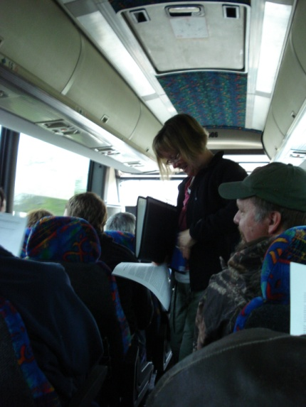
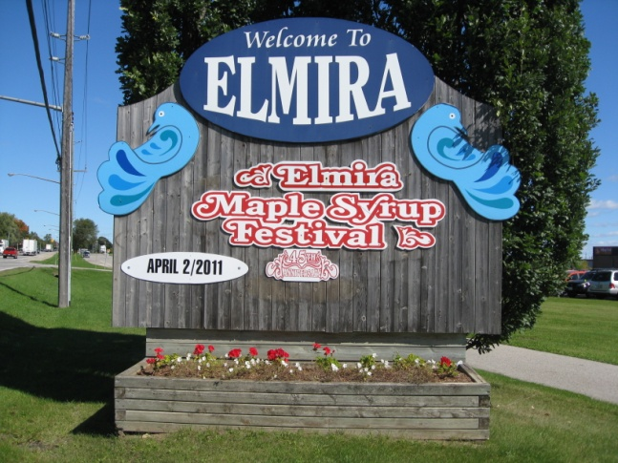
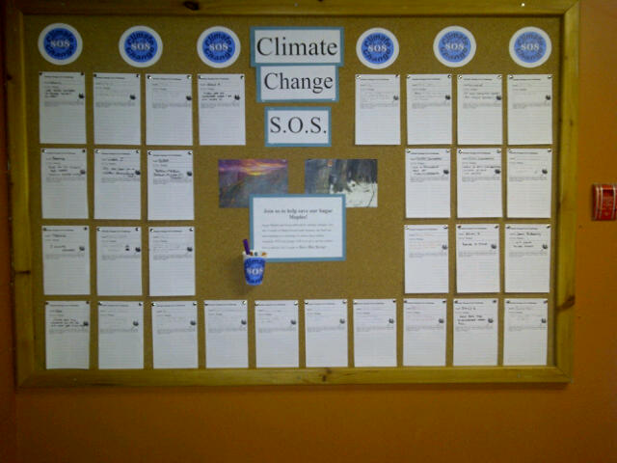
Ongoing Research
Maple Syrup and Climate Change (x2)
Maple Syrup Value Systems
Maple Syrup SOS (Save our Syrup)
Elmira Maple Syrup Festival and Wellbeing

Slide 6
Maple Syrup Value Systems Research
Completed 35 interviews – 2013
Currently undertaking focus groups – spring 2014
Synthesis and final deliverables - 2015

Slide 7
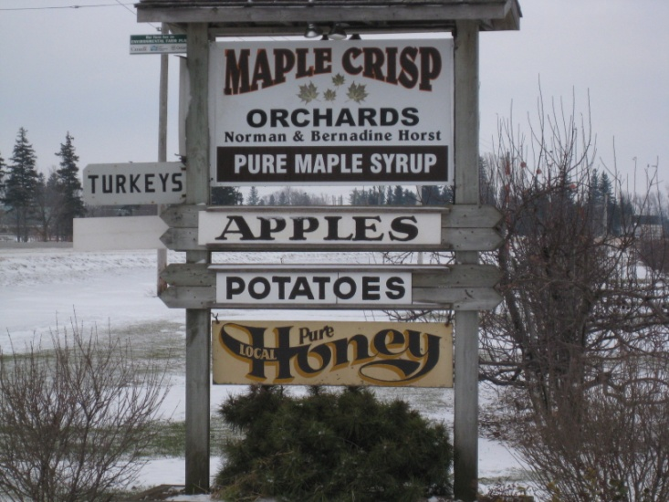
NTFPs
Non-Timber Forest Product (NTFP)
  Biological Resources, Products and Services Harvested From Forests for Subsistence and/or Trade
    Undervalued, but currently experiencing a renaissance
    Valuable to both Aboriginal and rural communities
Notes:
Lack good data, dwarfed by timber, rural marginal status, part-time activity, tied to subsistence economy
Rural spaces: Sustainable alternative to timber
Urban spaces: Green. buy local, organic demand

Slide 8
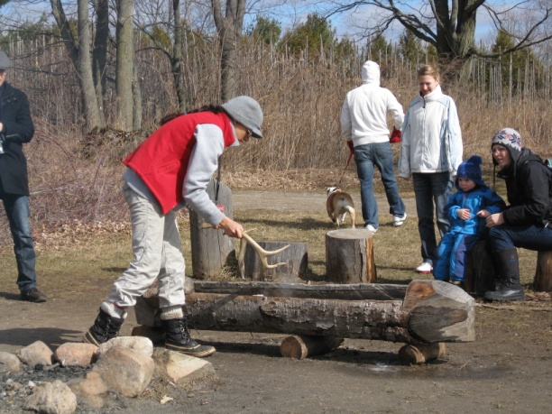
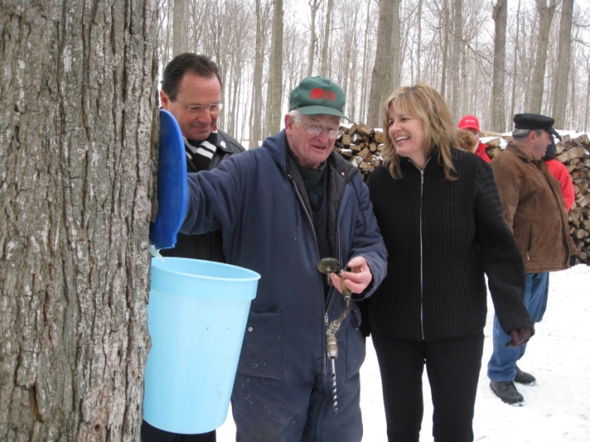
Maple Syrup
  Important Canadian NTFP
    Contributes “Value”
      What do these values look like in rural vs Aboriginal contexts?

Slide 9
“Value”
Noun - The regard that something is held to deserve; the importance, worth, or usefulness of something
Verb – Estimate the monetary worth; Consider something to be important
http://www.oxforddictionaries.com/us/definition/american_english/value

Slide 10
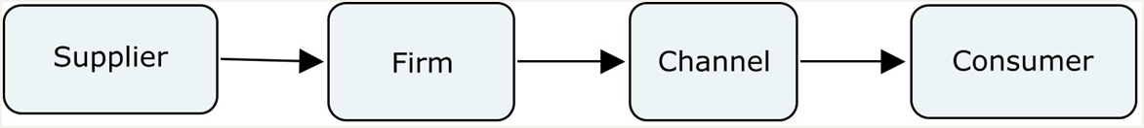
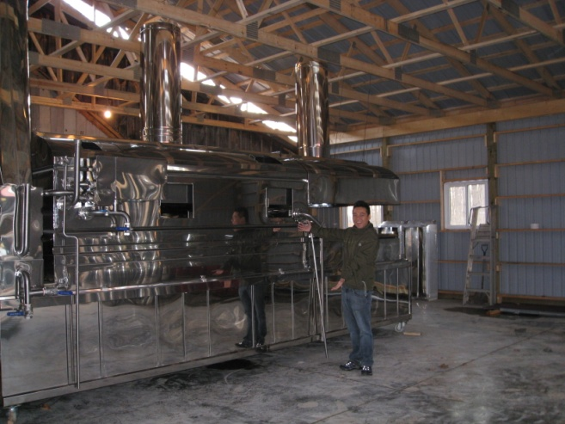
Economic “Value Systems”

Slide 11
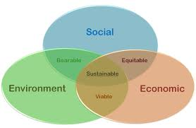
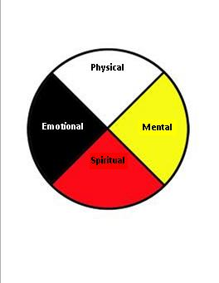
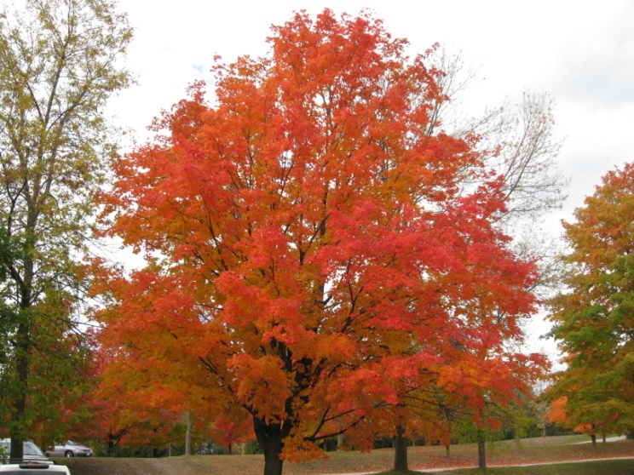
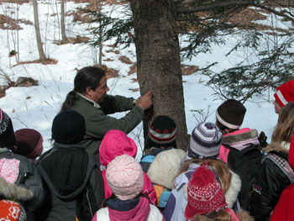
Alternate Value Systems
Notes:
South Nation Conservation https://www.nation.on.ca/resources/watershed-education/maple-syrup-education-program

Slide 12
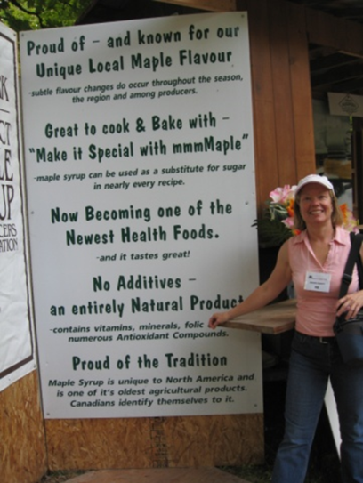

Slide 13
Aboriginal Perspectives

Slide 14
Closings: Sunset
(Wrap-up)
All My Relations
(Aboriginal Values)
Sharing Ways of Knowing
(Knowledge Transmission
& Mobilization)
Openings: Sunrise
(Preparation Ceremonies)
Harvesting Practices
(Production)
Aboriginal Perspectives of the Maple Value System

Slide 15
Rural/Farmer Perspectives

Slide 17
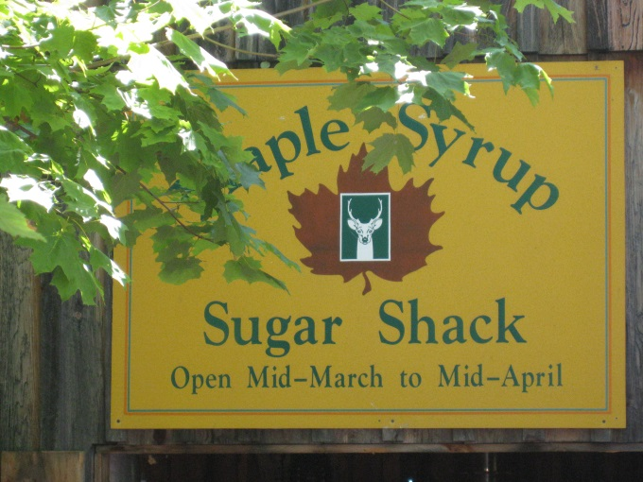
Conclusion
Values Held
  Some similarities in the types of values
    E.g. environment, family, community, health
  But also some differences
    E.g. spiritual/sacred, medicinal
Highlights differences in “ways of knowing” and worldviews
  How these values are understood and practiced

Slide 18
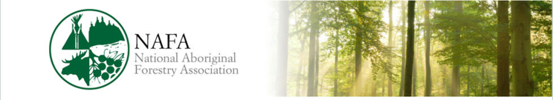



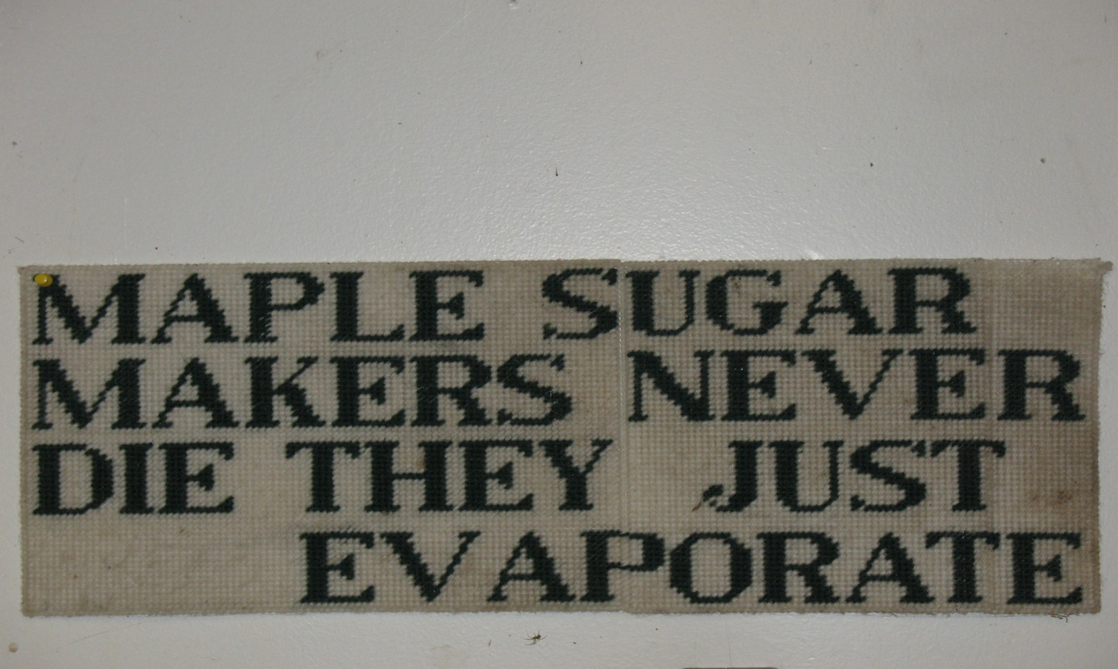



Questions?

