Slide 1
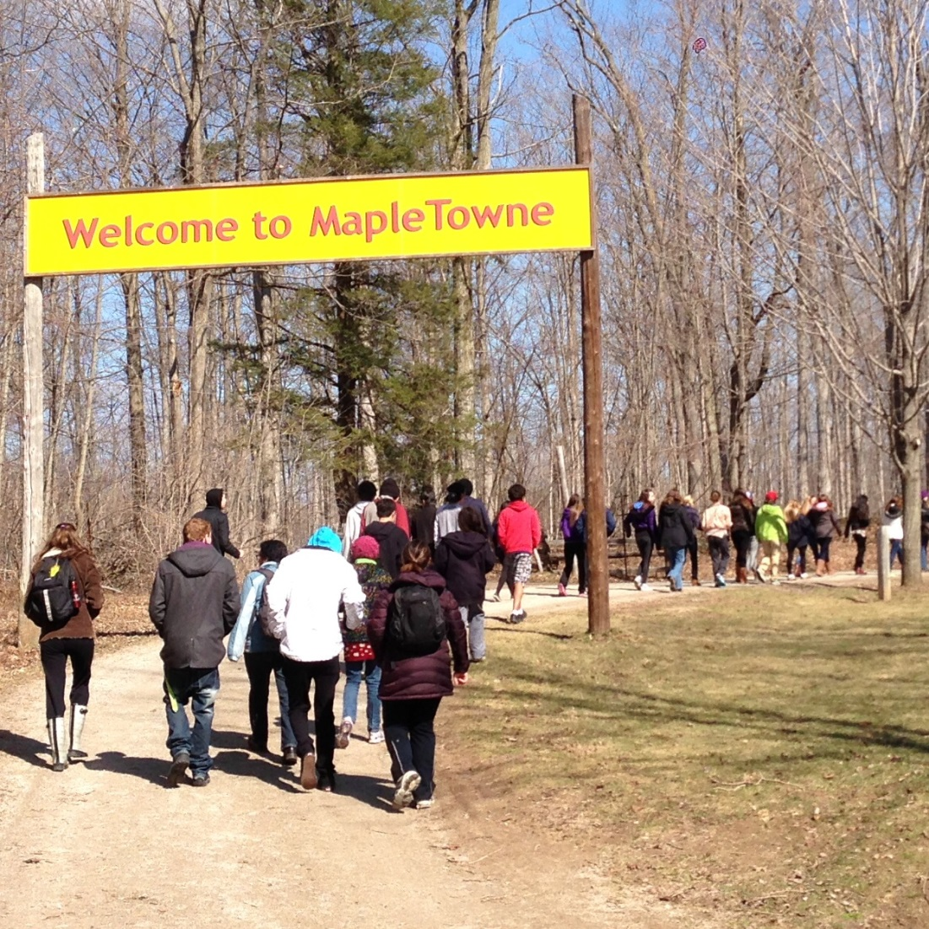
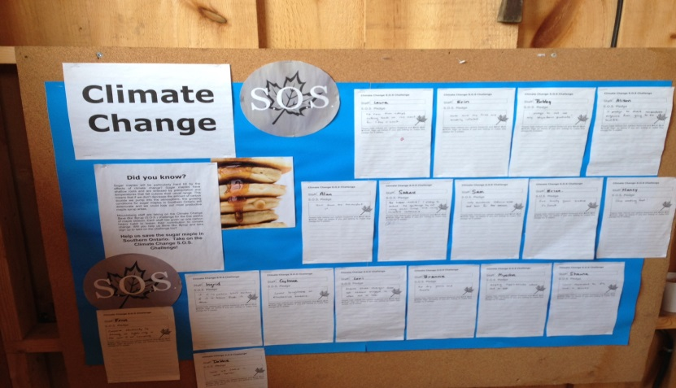
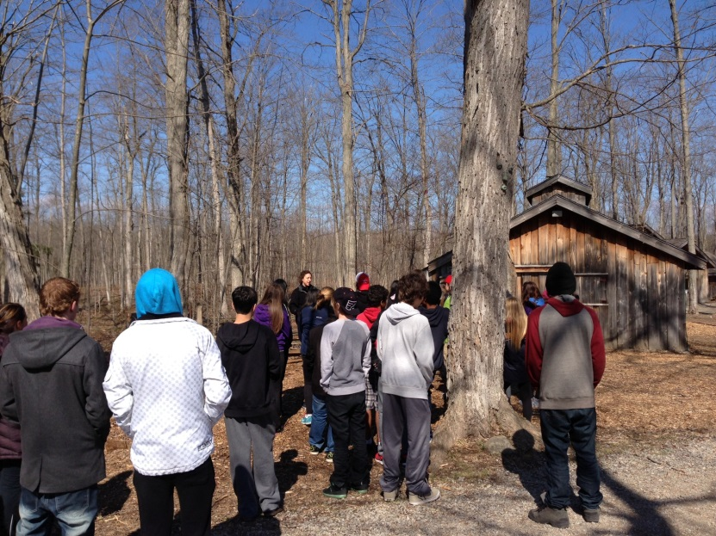
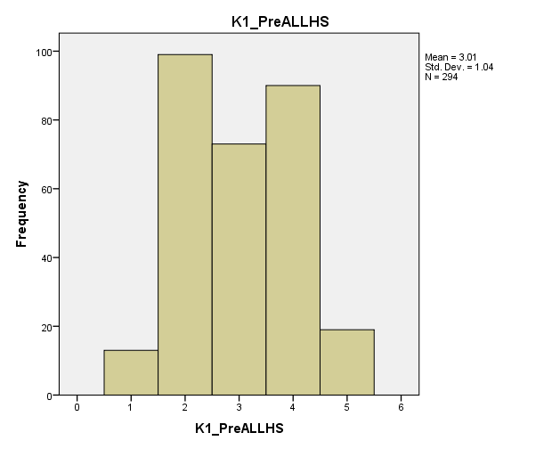
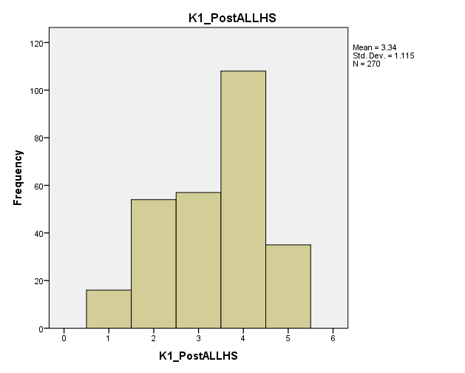
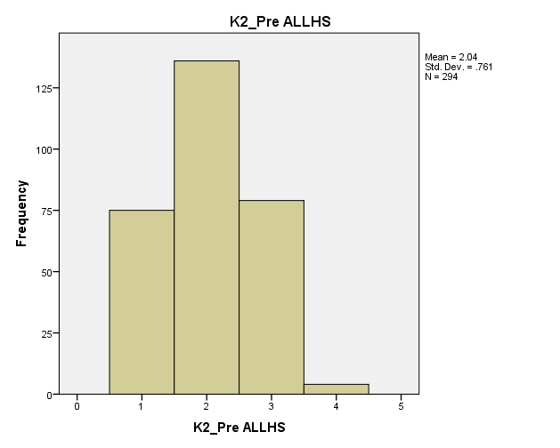
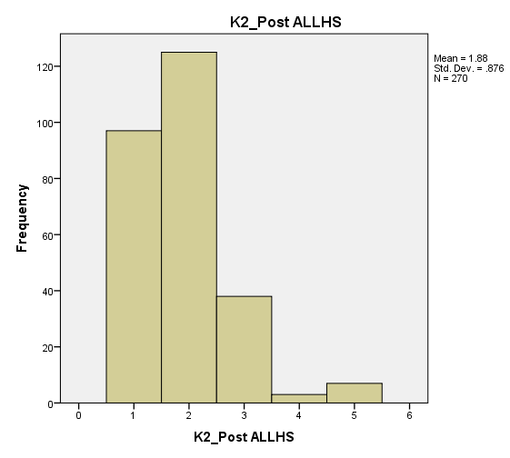
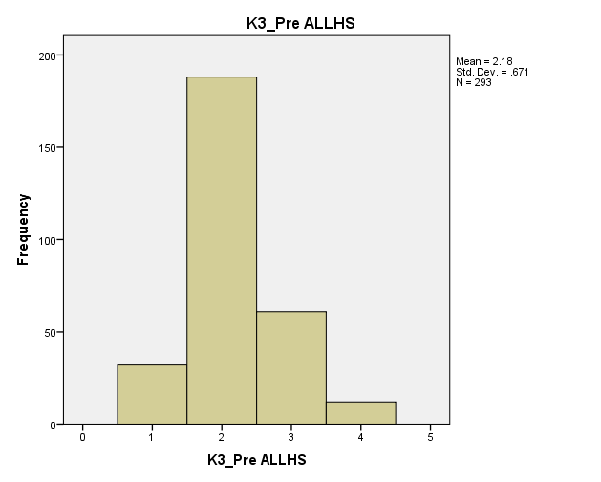
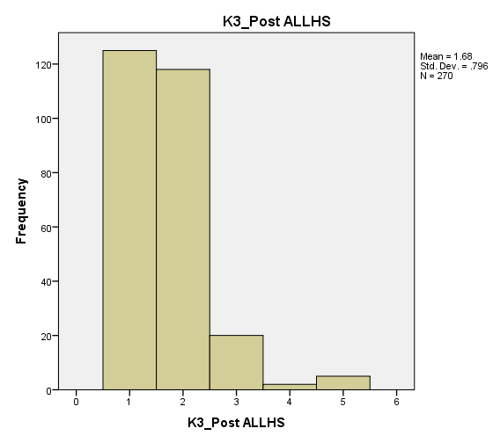
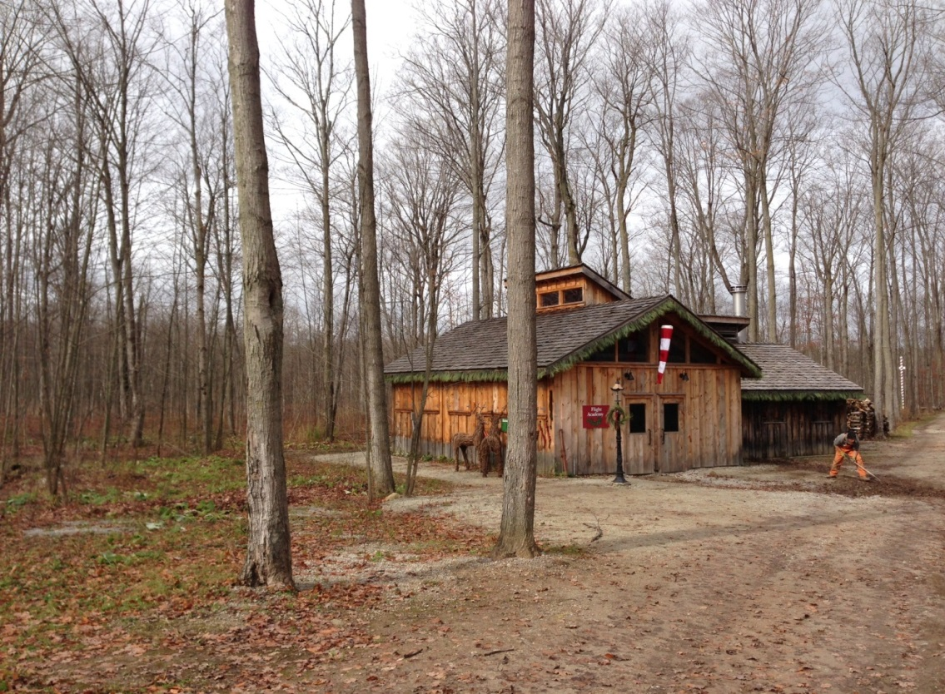
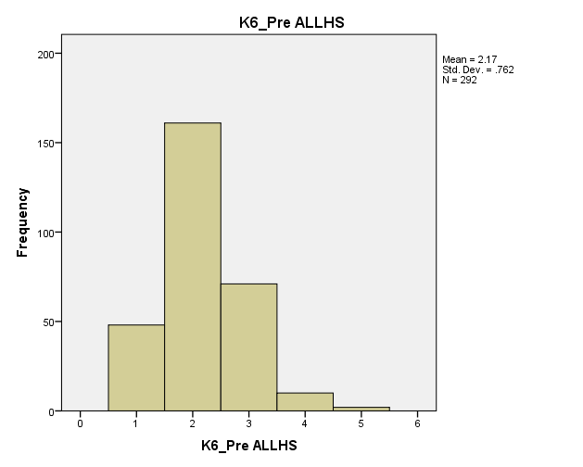
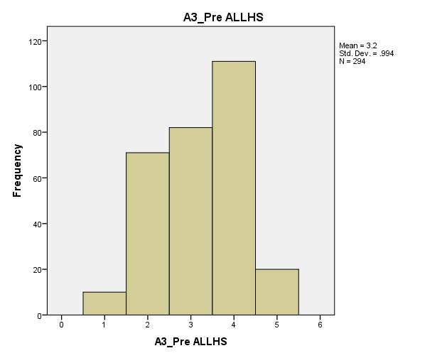
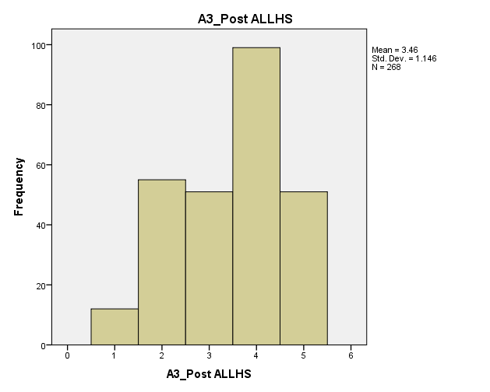
Climate Change SOS: Save Our Syrup!
Dr. Brenda Murphy¹, Mr. Bryce Gunson², Ms. Brenna Bartley³, Dr. Jennifer Baltzer⁴, Dr. Laura Brown⁵, Dr. David Morris⁶
^{1,2,4,5,6} Wilfrid Laurier University. Brantford Ontario Canada; ³ Conservation Halton, Mountsberg Conservation Area. Campbellville Ontario Canada
Program Overview
Climate Change S.O.S. is a program geared towards high school students highlighting the effect of climate change on the sugar maple and maple syrup.
The program brings students to the Mountsberg Conservation Area where they explore a working maple sugar bush. Students monitor the health of the sugar bush and contribute to an ongoing data set. They also learn about the threats faced by the sugar maple, and examine the economic and cultural impact of the potential loss of these trees, and ultimately go home with real world techniques they can use for reducing their own carbon footprint.
Research Question
To what extent does sharing knowledge about the impacts of climate change about sugar maple ecosystems and maple syrup influence the participant's knowledge, attitudes, and behaviours towards climate change?
•The knowledge mobilization assessment project utilizes a pre & post survey to measure the students knowledge, attitudes & behaviours towards climate change.
Data Analysis
517 surveys completed
Using the Mann Whitney U test, the following 5 questions indicated statistically significant changes in student response (K= Knowledge questions; A=Attitudes question)
K1. Changes in climate temperature are so small and so gradual that plants and animals can adapt.
1. Strongly Agree 2. Agree 3. Neutral 4. Disagree 5. Strongly Disagree
K2. Biodiversity is essential to the health of ecosystems.
1. Strongly Agree 2. Agree 3. Neutral 4. Disagree 5. Strongly Disagree
K3. Climate change is affecting the timing of the maple syrup collection season.
1. Strongly Agree 2. Agree 3. Neutral 4. Disagree 5. Strongly Disagree
Pre-Test (Before the Program) Post-Test (After the Program)
Pre-Test (Before the Program) Post-Test (After the Program)
Pre-Test (Before the Program) Post-Test (After the Program)
K6. The maple syrup ‘value chain’ involves producers, distributers, retailers and customers.
1. Strongly Agree 2. Agree 3. Neutral 4. Disagree 5. Strongly Disagree
A3. I don’t think there is very much I could do to lessen the impacts of climate change.
1. Strongly Agree 2. Agree 3. Neutral 4. Disagree 5. Strongly Disagree
Pre-Test (Before the Program) Post-Test (After the Program)
Pre-Test (Before the Program) Post-Test (After the Program)
Results from the 517 surveys indicate:
Positive changes in knowledge of climate change & maple syrup
Positive changes in students attitudes regarding their ability to lessen their impact on climate change.
Although we didn’t see a statistically significant change in behaviour towards climate change, the literature indicates this is the hardest attribute to change.
Overall, feedback from both students and teachers has been extremely positive.
Acknowledgements
We want to thank the support of Conservation Halton Mountsberg (and their anonymous donor), Wilfrid Laurier University, Canada Social Sciences and Humanities Research Council, and the Canadian TREE Fund. We would also like to thank Dr. Brenda Murphy, Dr. Jennifer Baltzer, Dr. David Morris, Dr. Laura Brown and Bryce Gunson from WLU and Conservation Halton’s Education (Mountsberg) and Forestry staff.
Corresponding Author: Bryce Gunson 519 756 8228 ext. 5405 bgunson@wlu.ca

