Slide 1
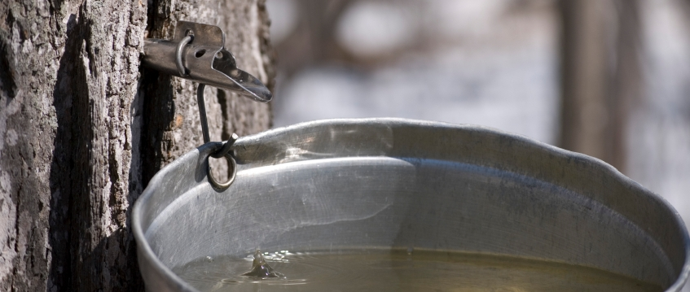
Maple Practices Toolkit
Indigenous Maple Syrup Knowledge Network [IMSKN] Presents:

Slide 2
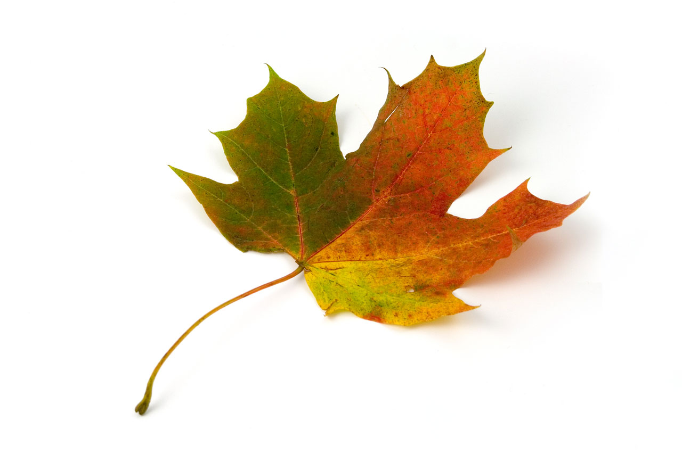
IMSKN?
The Indigenous Maple Syrup Knowledge Network
Goal: Support the transmission of knowledge & revitalization of maple practices & contribute to the long-term sustainability of the maple industry amongst the Ontario Aboriginal population

Slide 3
Meet the Team…
IMSKN is a growing collaboration between Ontario First Nations & Metis individuals/communities & Wilfrid Laurier University
Dr. Annette Chrétien
Dr. Brenda Murphy
Charlie Restoule

Slide 4
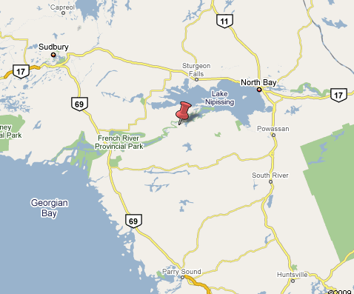
Maple Sugaring and the Dokis First Nation

Slide 5
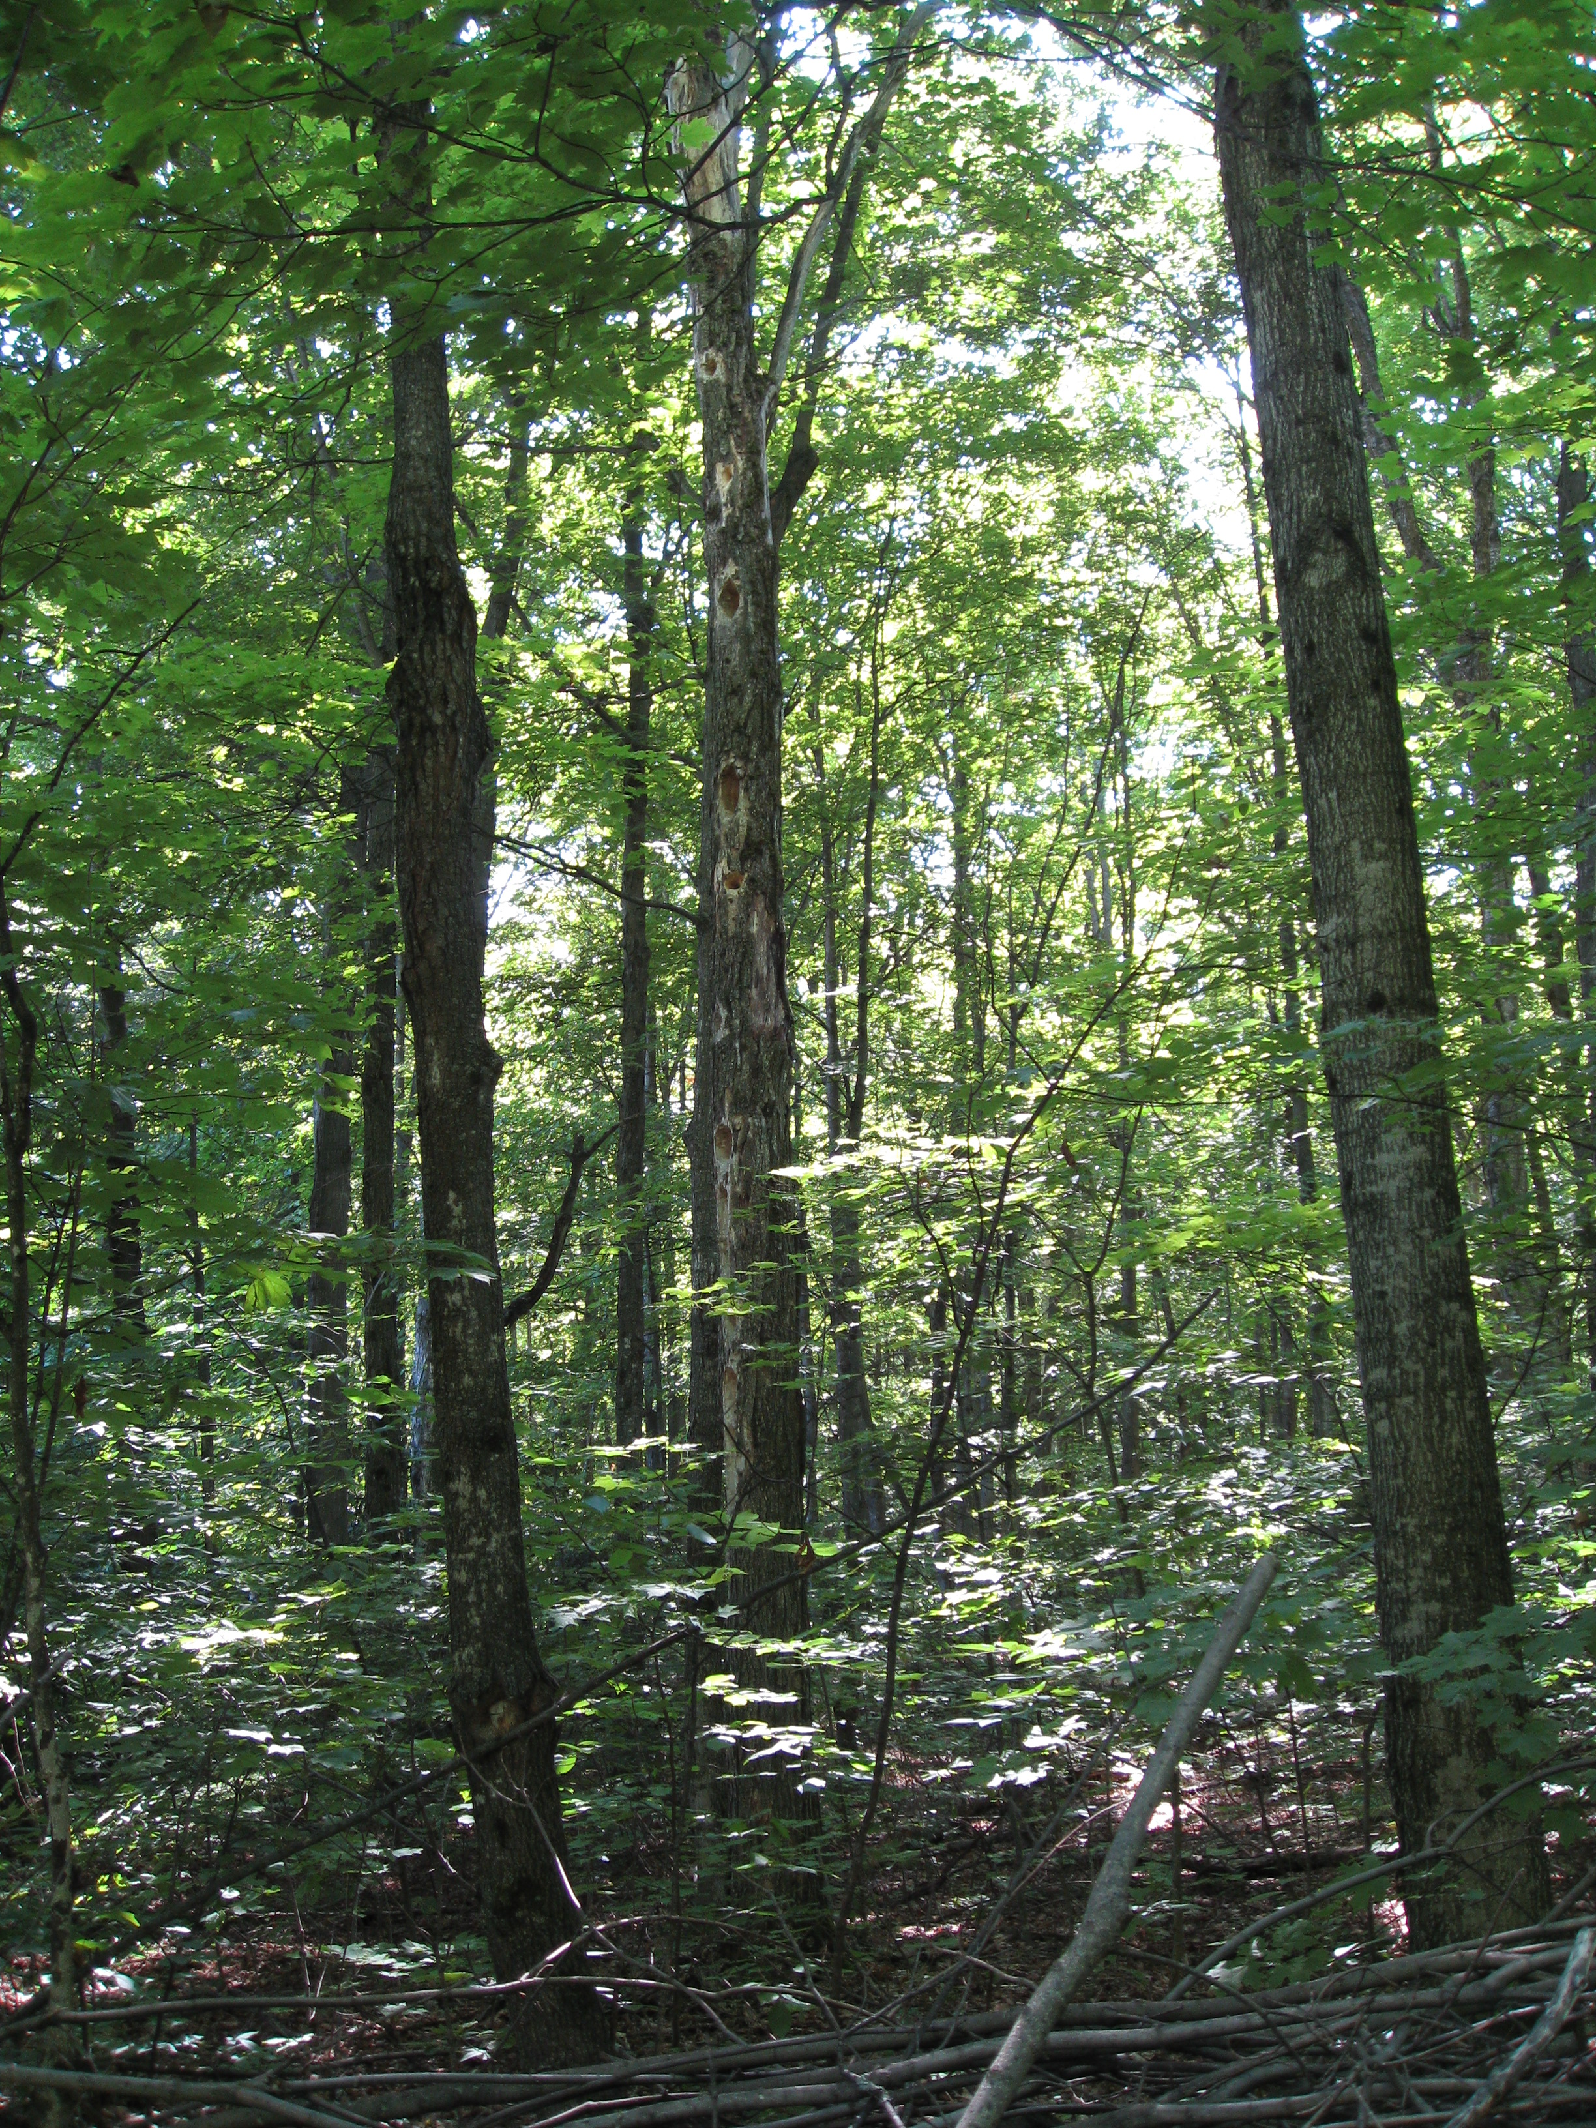
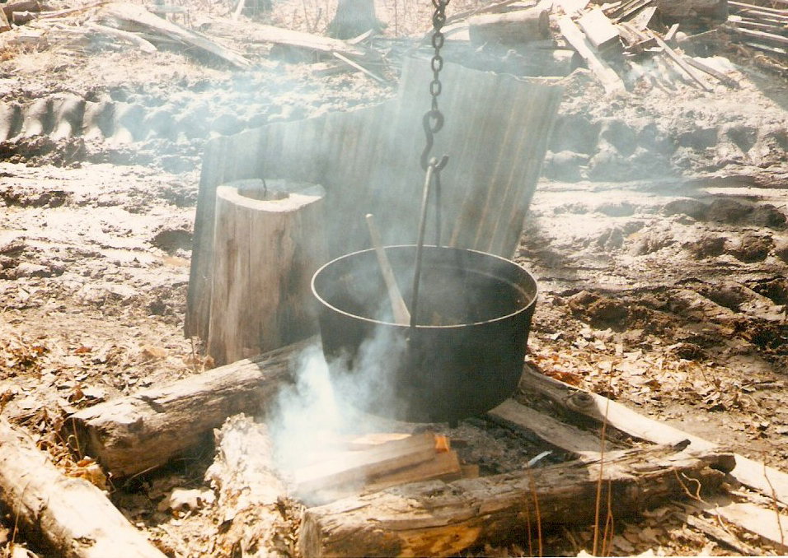
My Involvement in Production

Slide 6
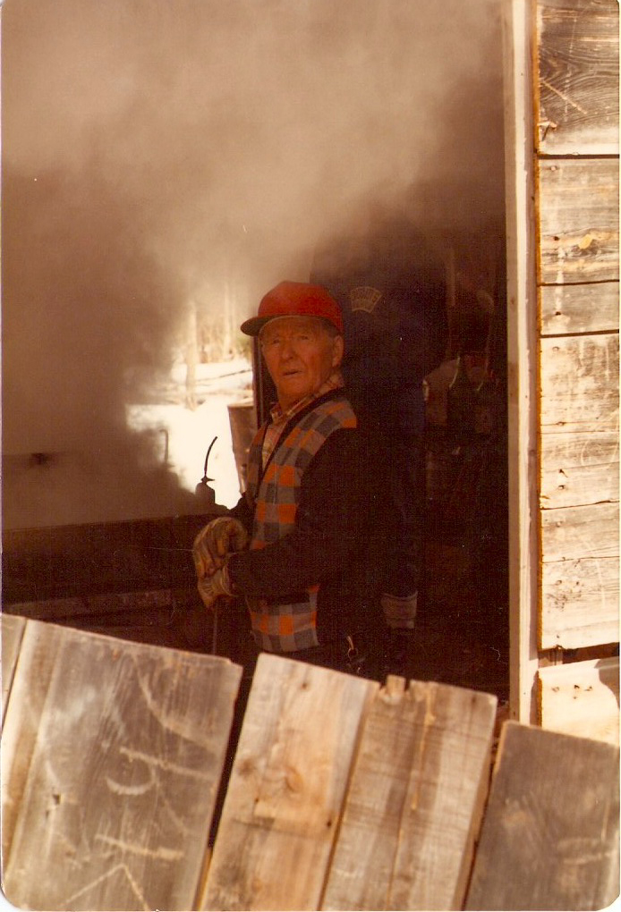
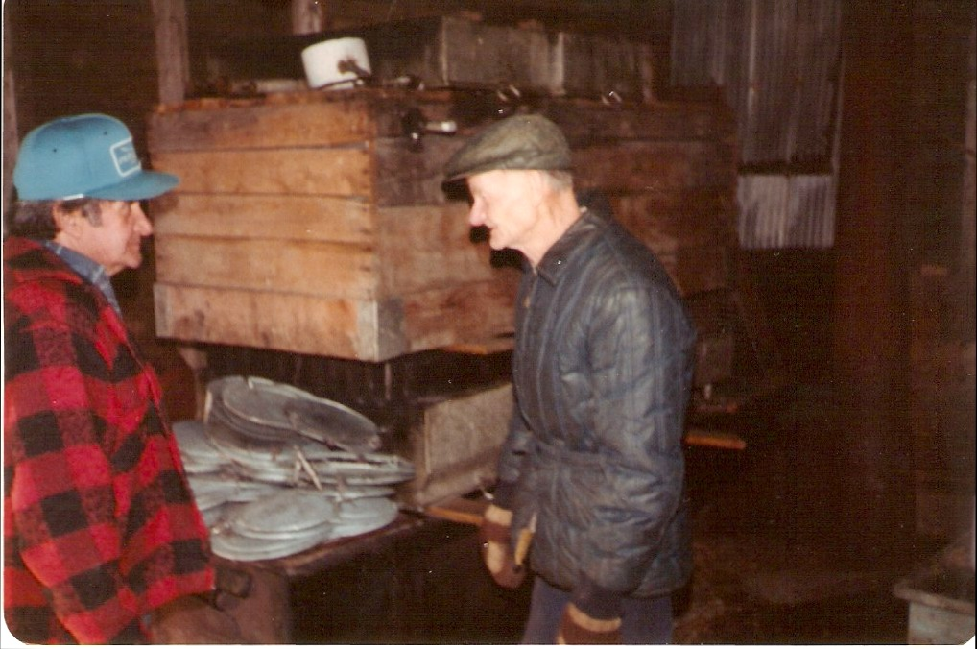

Slide 7
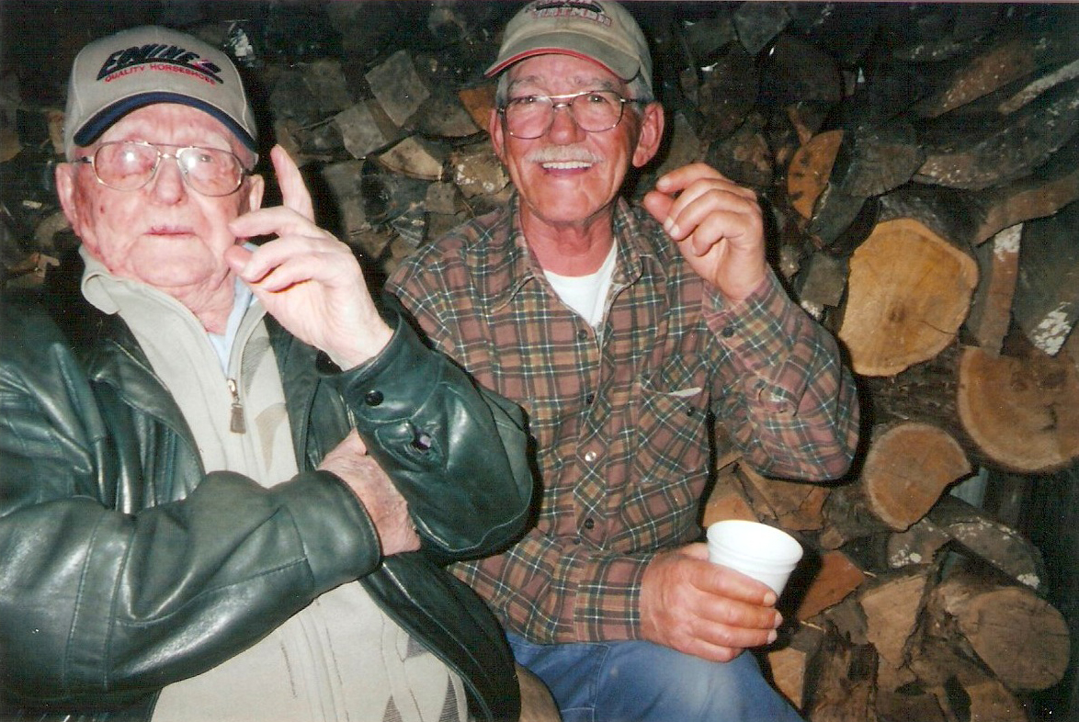

Slide 8
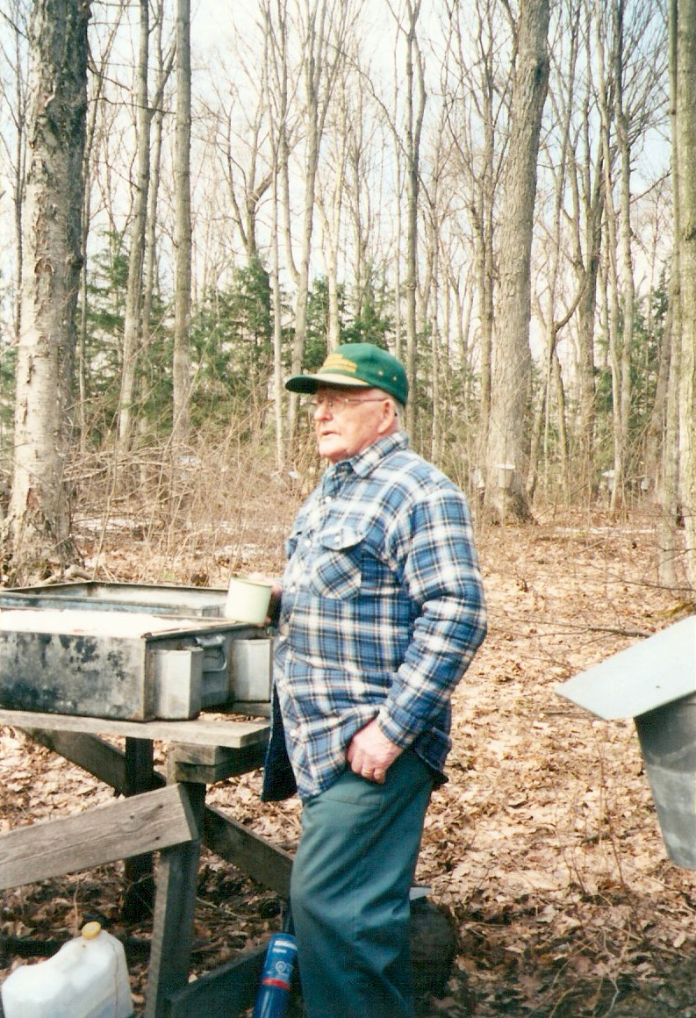
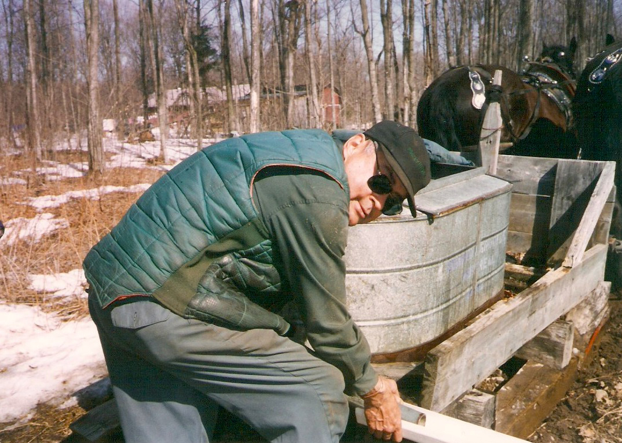
Restoule Family Sugar Bush

Slide 9
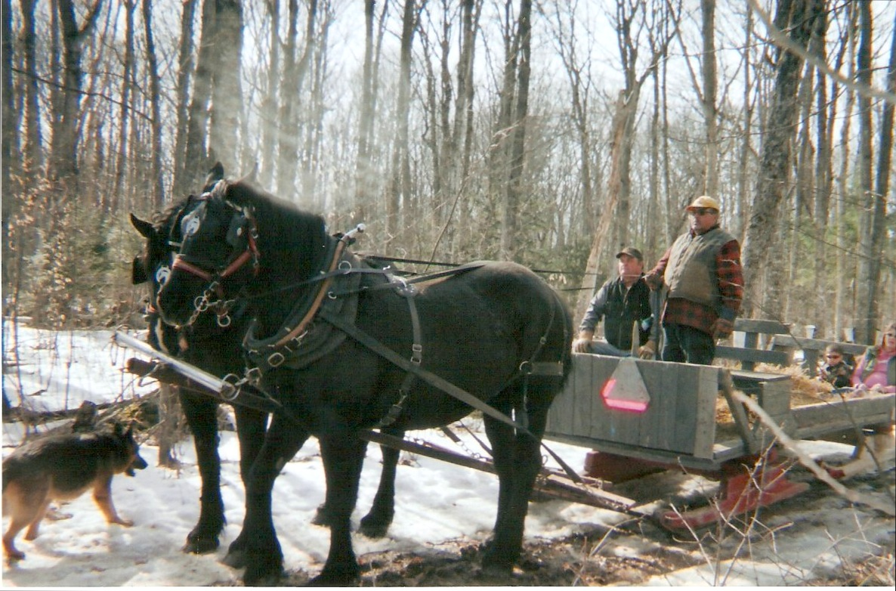
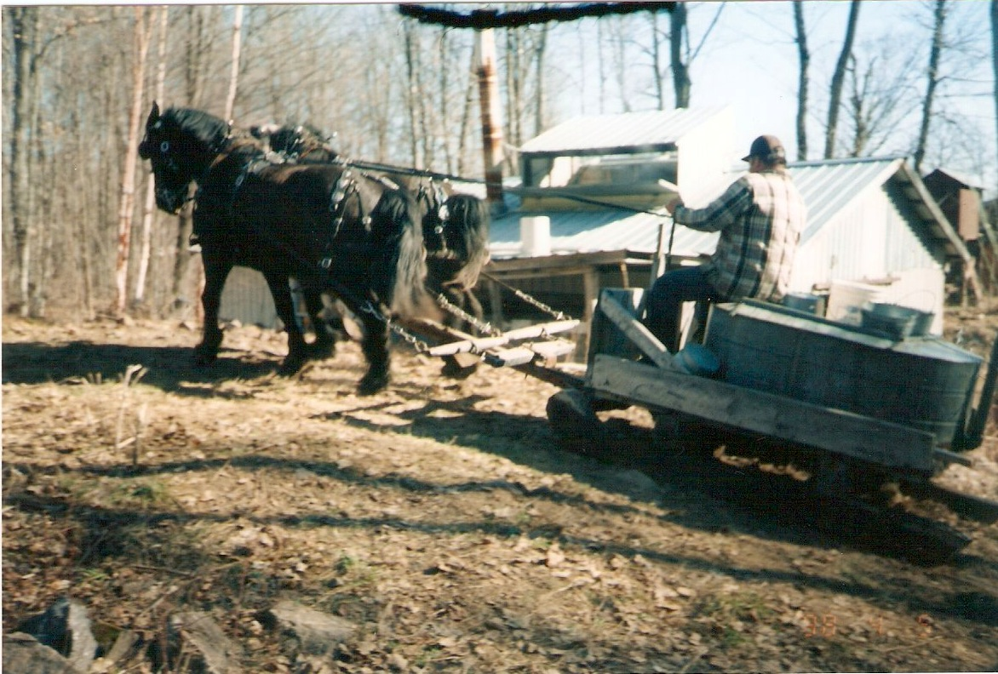

Slide 10
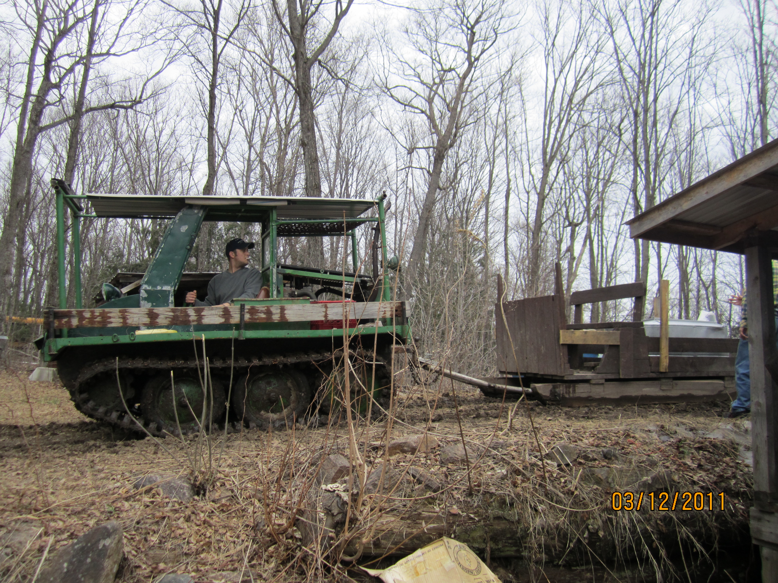

Slide 11
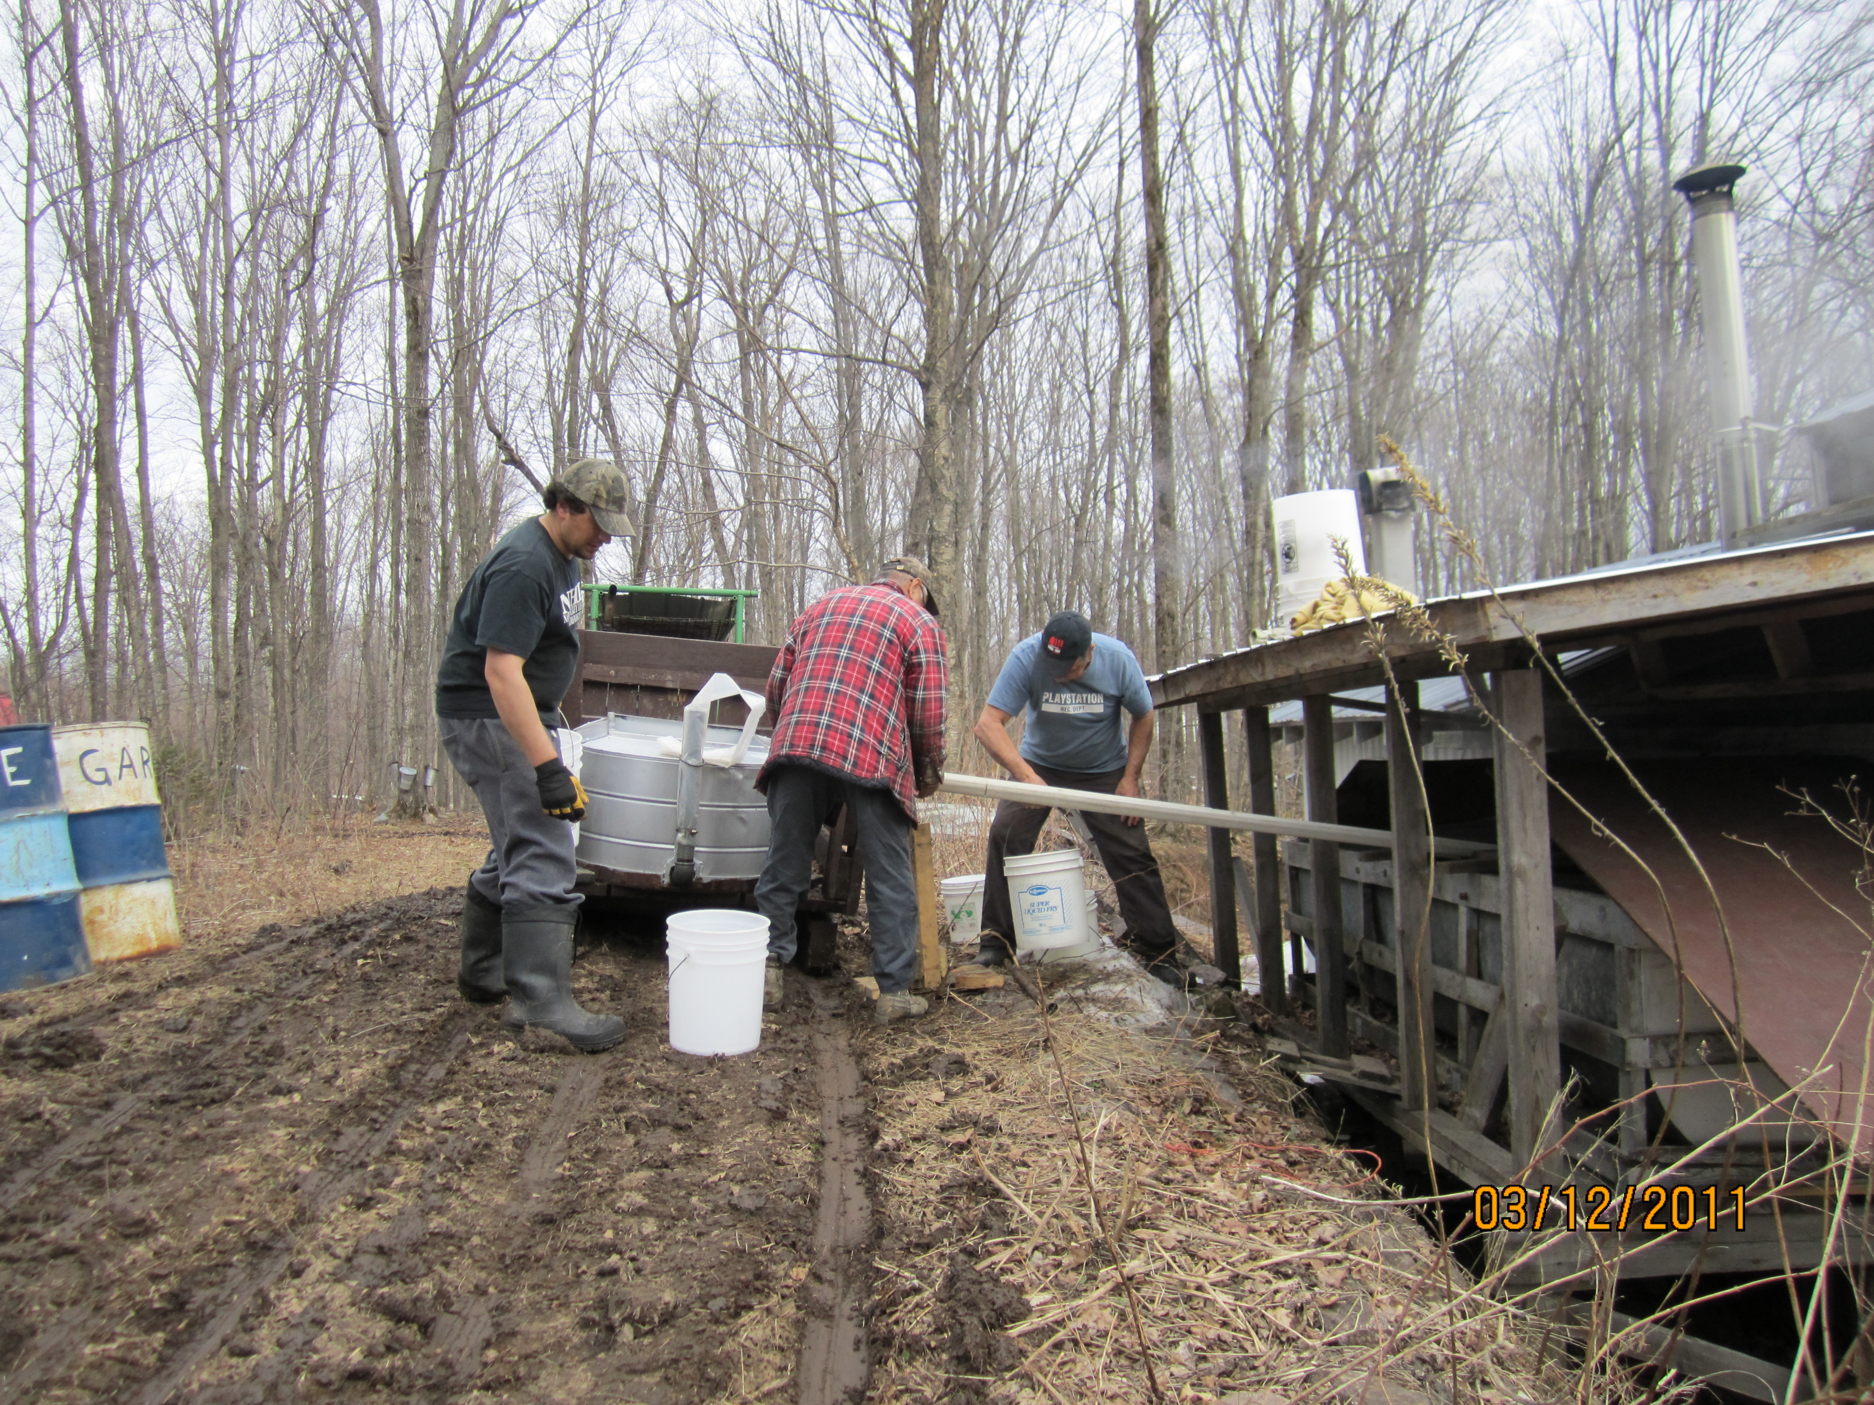

Slide 12
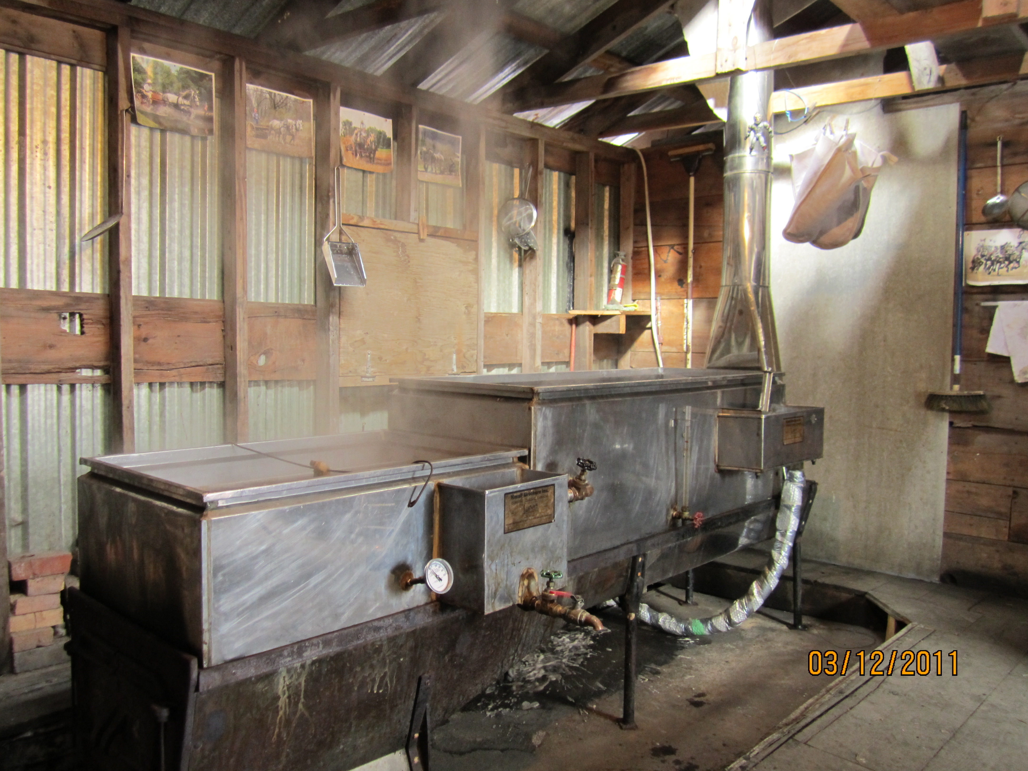
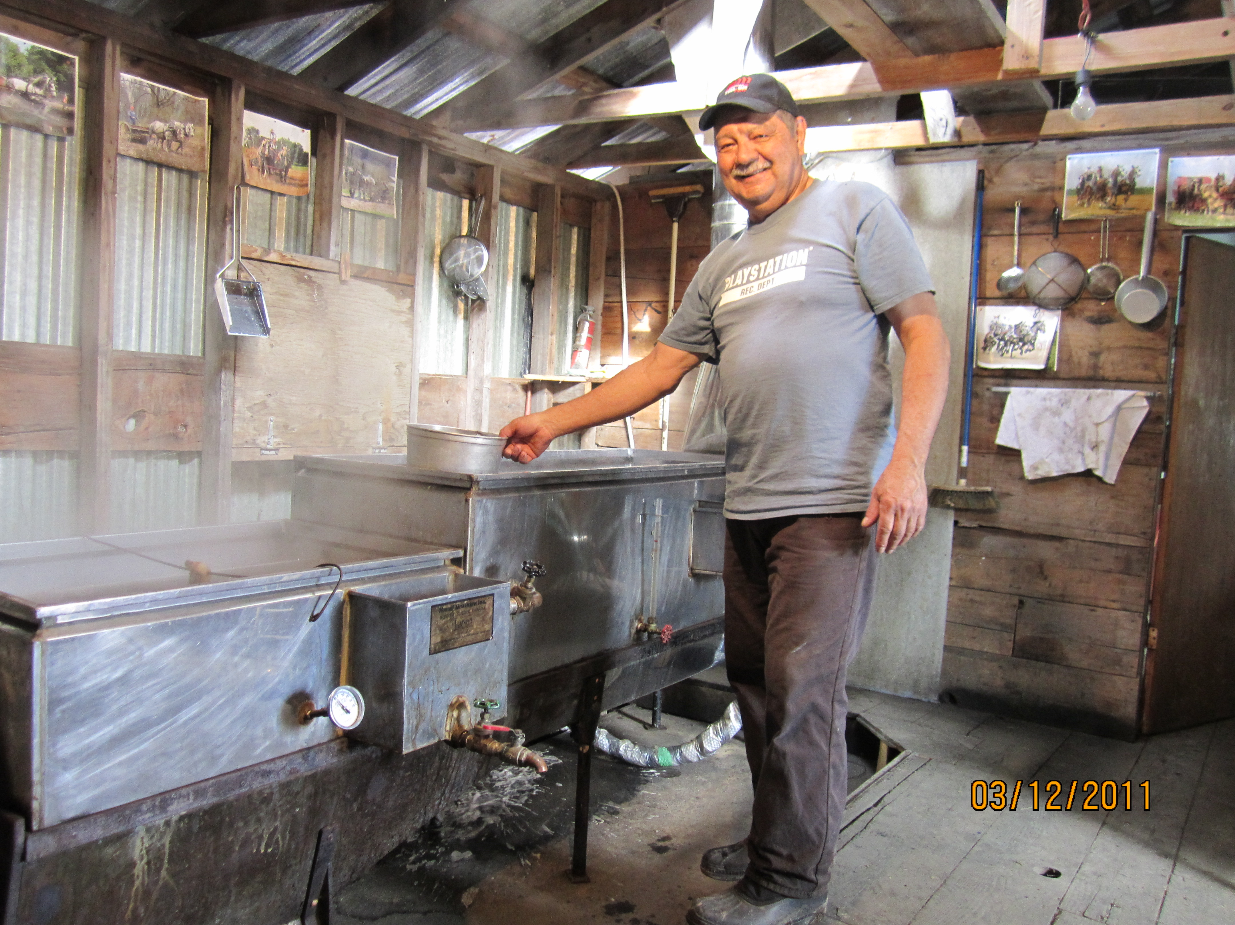
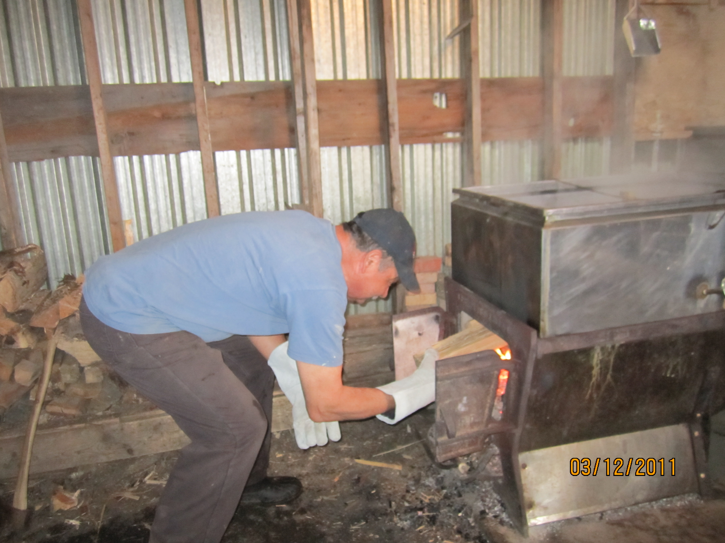

Slide 13
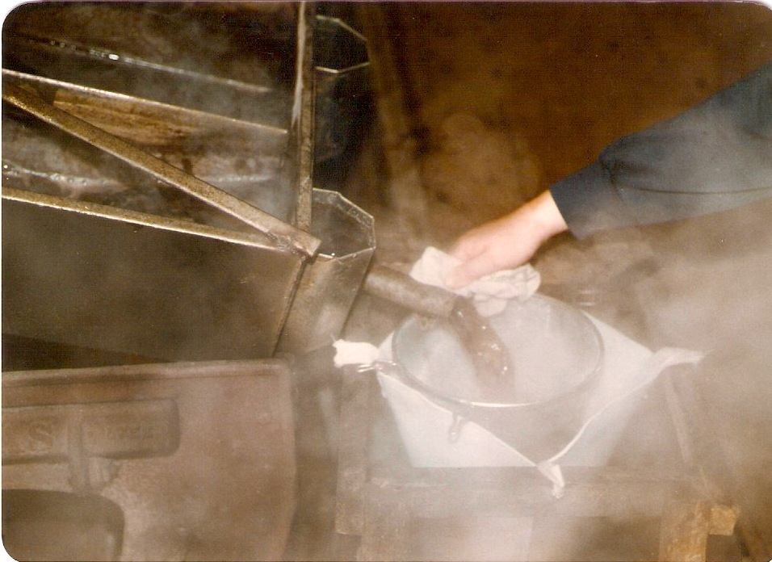

Slide 14
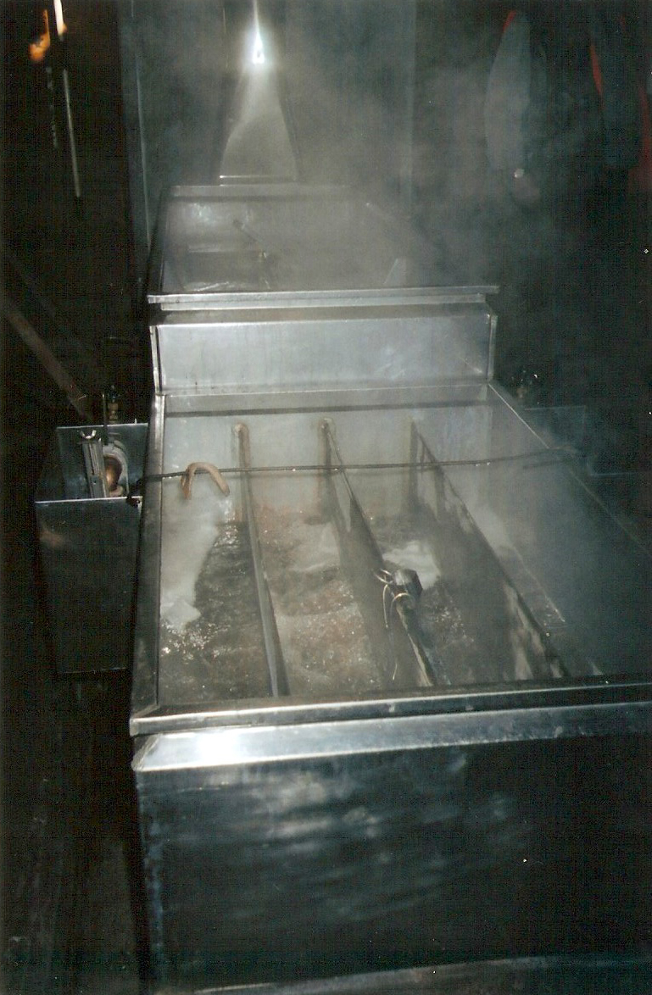
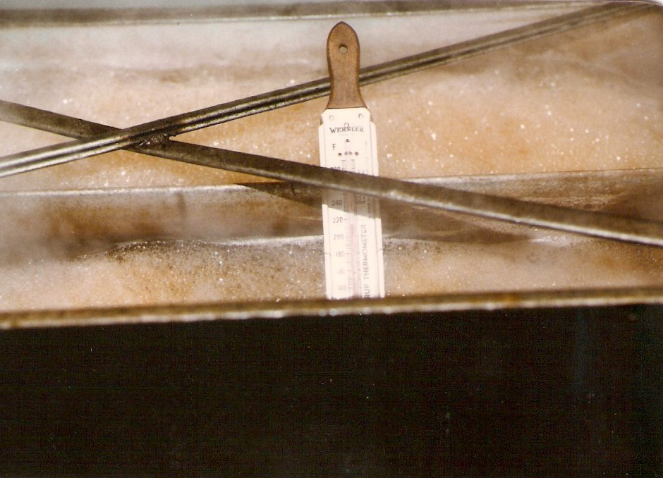

Slide 15
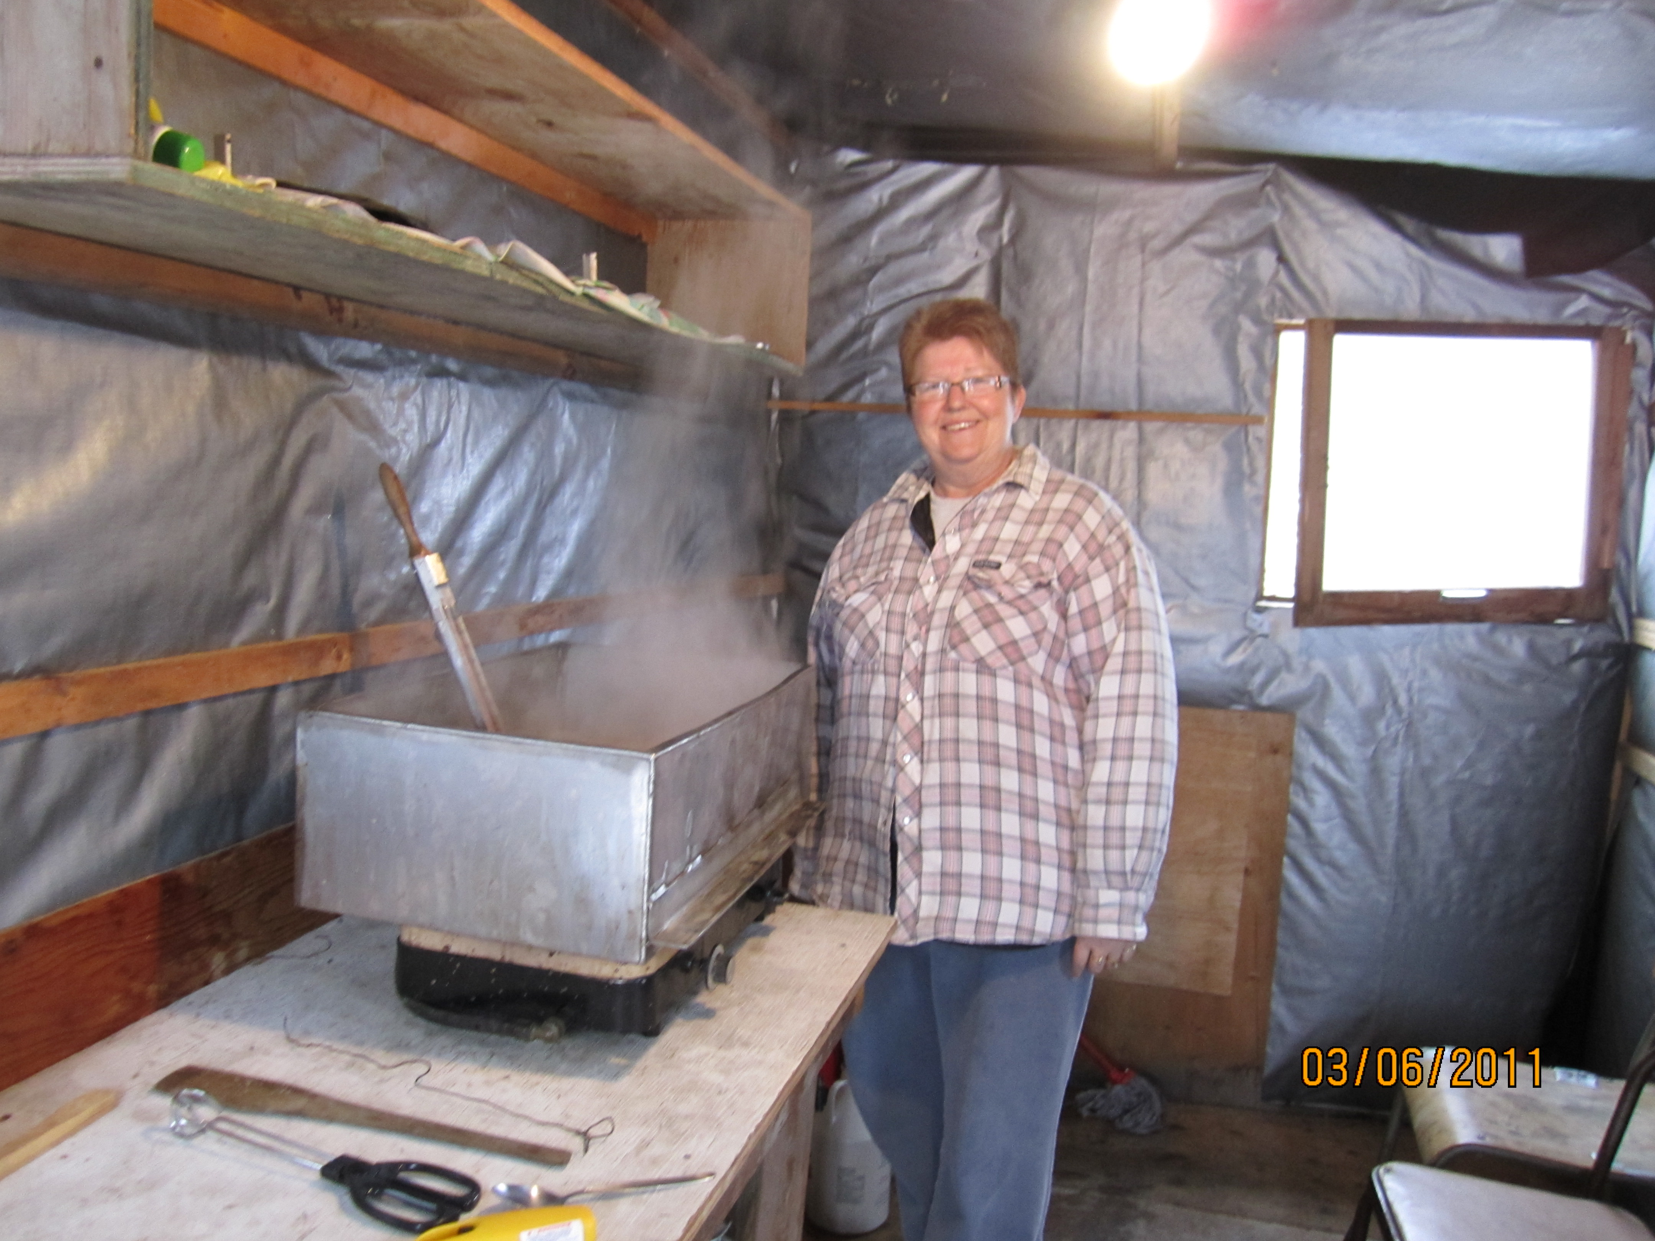

Slide 16
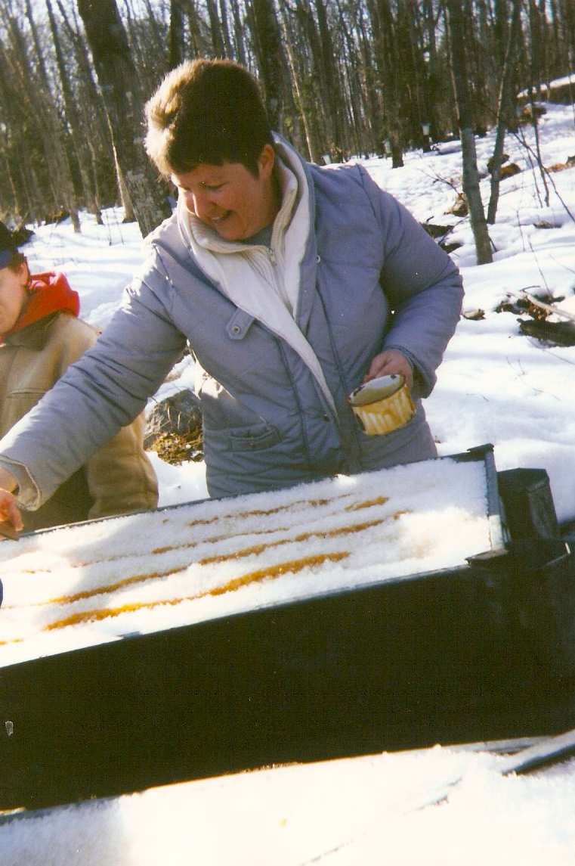
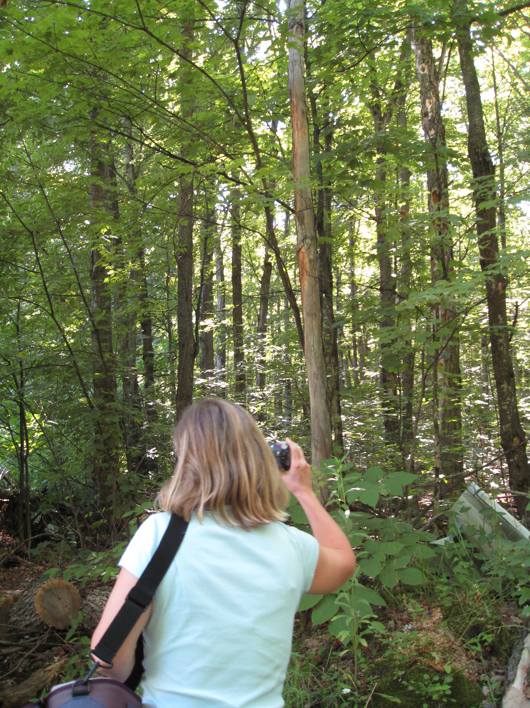

Slide 17
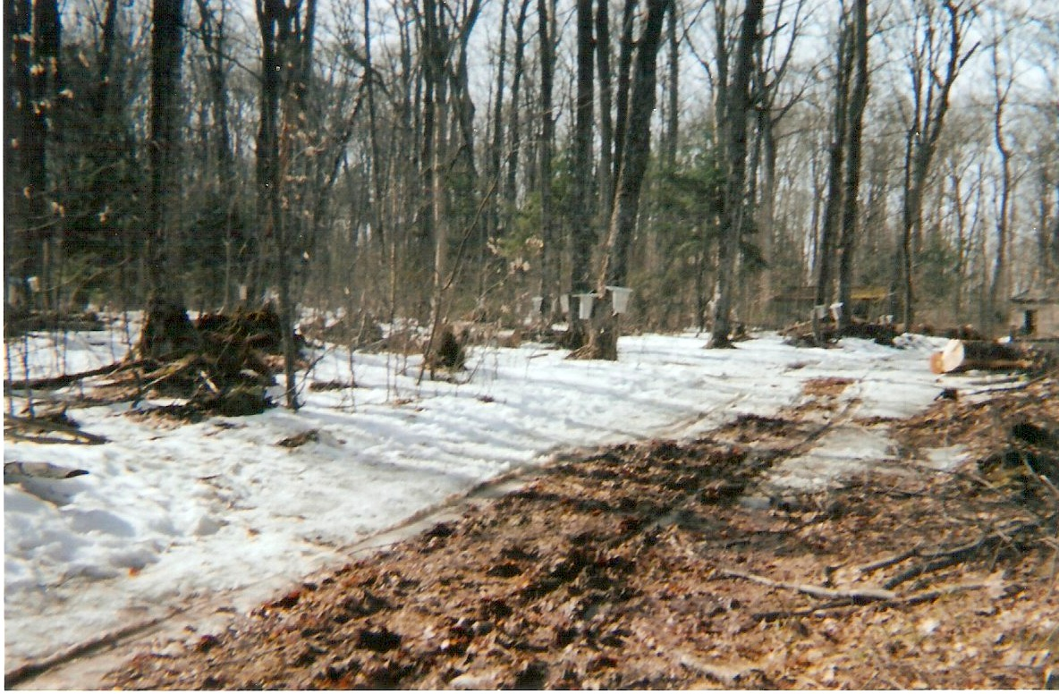
My Absence & Reinvolvement in the Sugar Bush

Slide 18
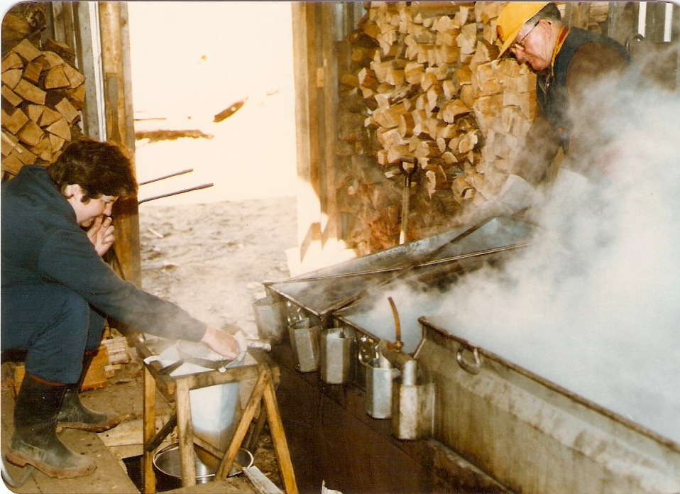
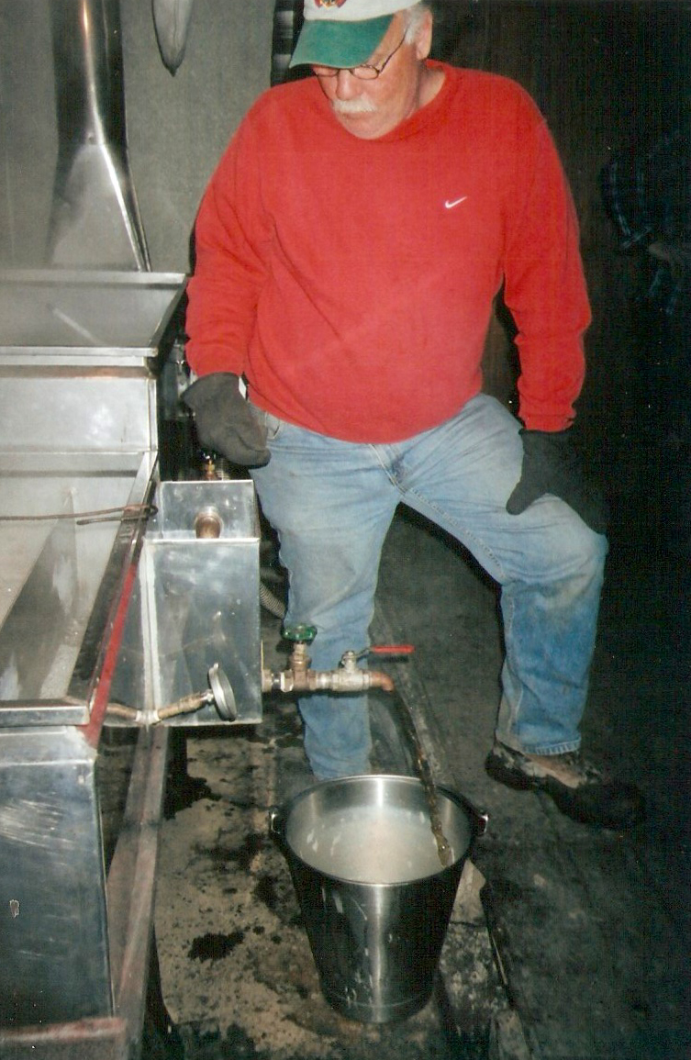
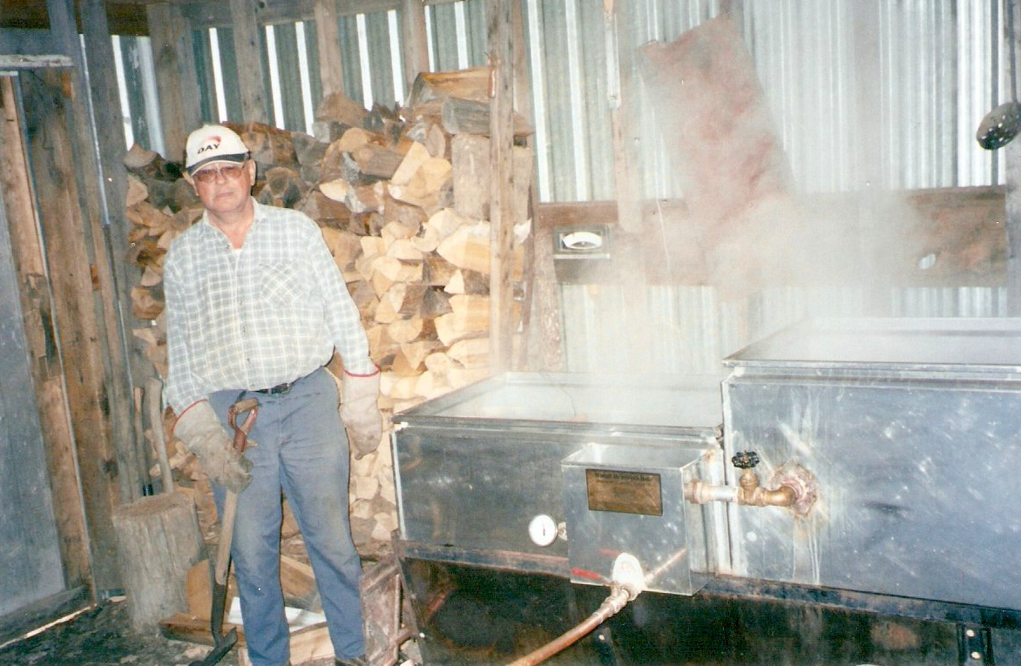
Loss of Sugar Bush From Dokis First Nation Community

Slide 19
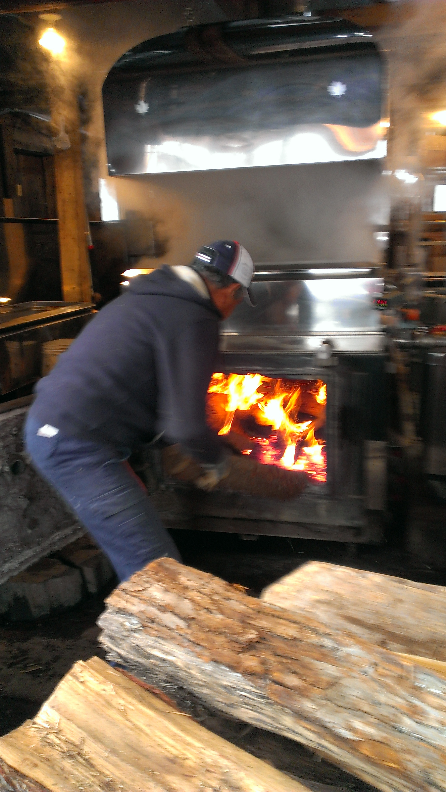
Seguin Family Sugar Bush

Slide 20
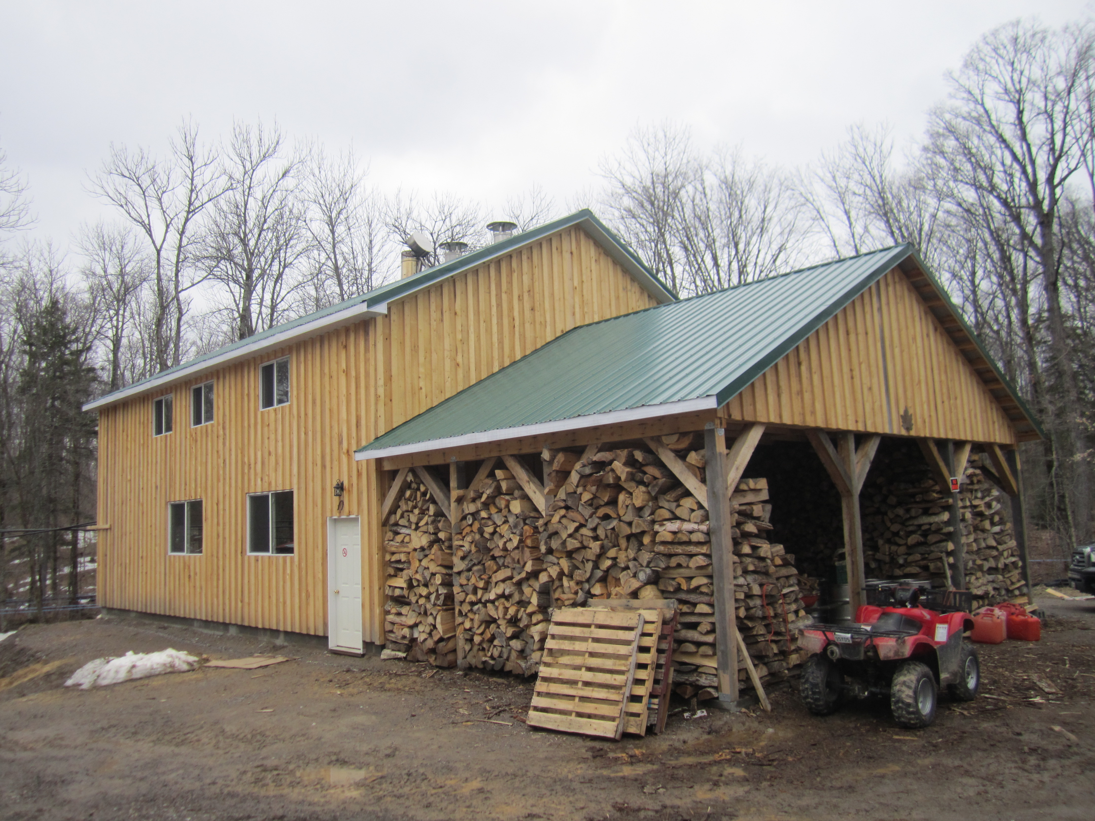
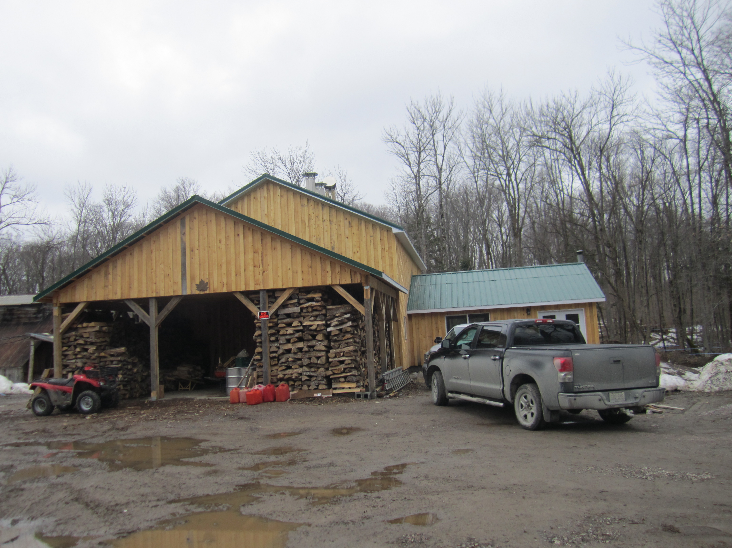

Slide 21
The Importance of Maple Sugaring for Indigenous Peoples & Communities
Self
Community
Culture

Slide 22
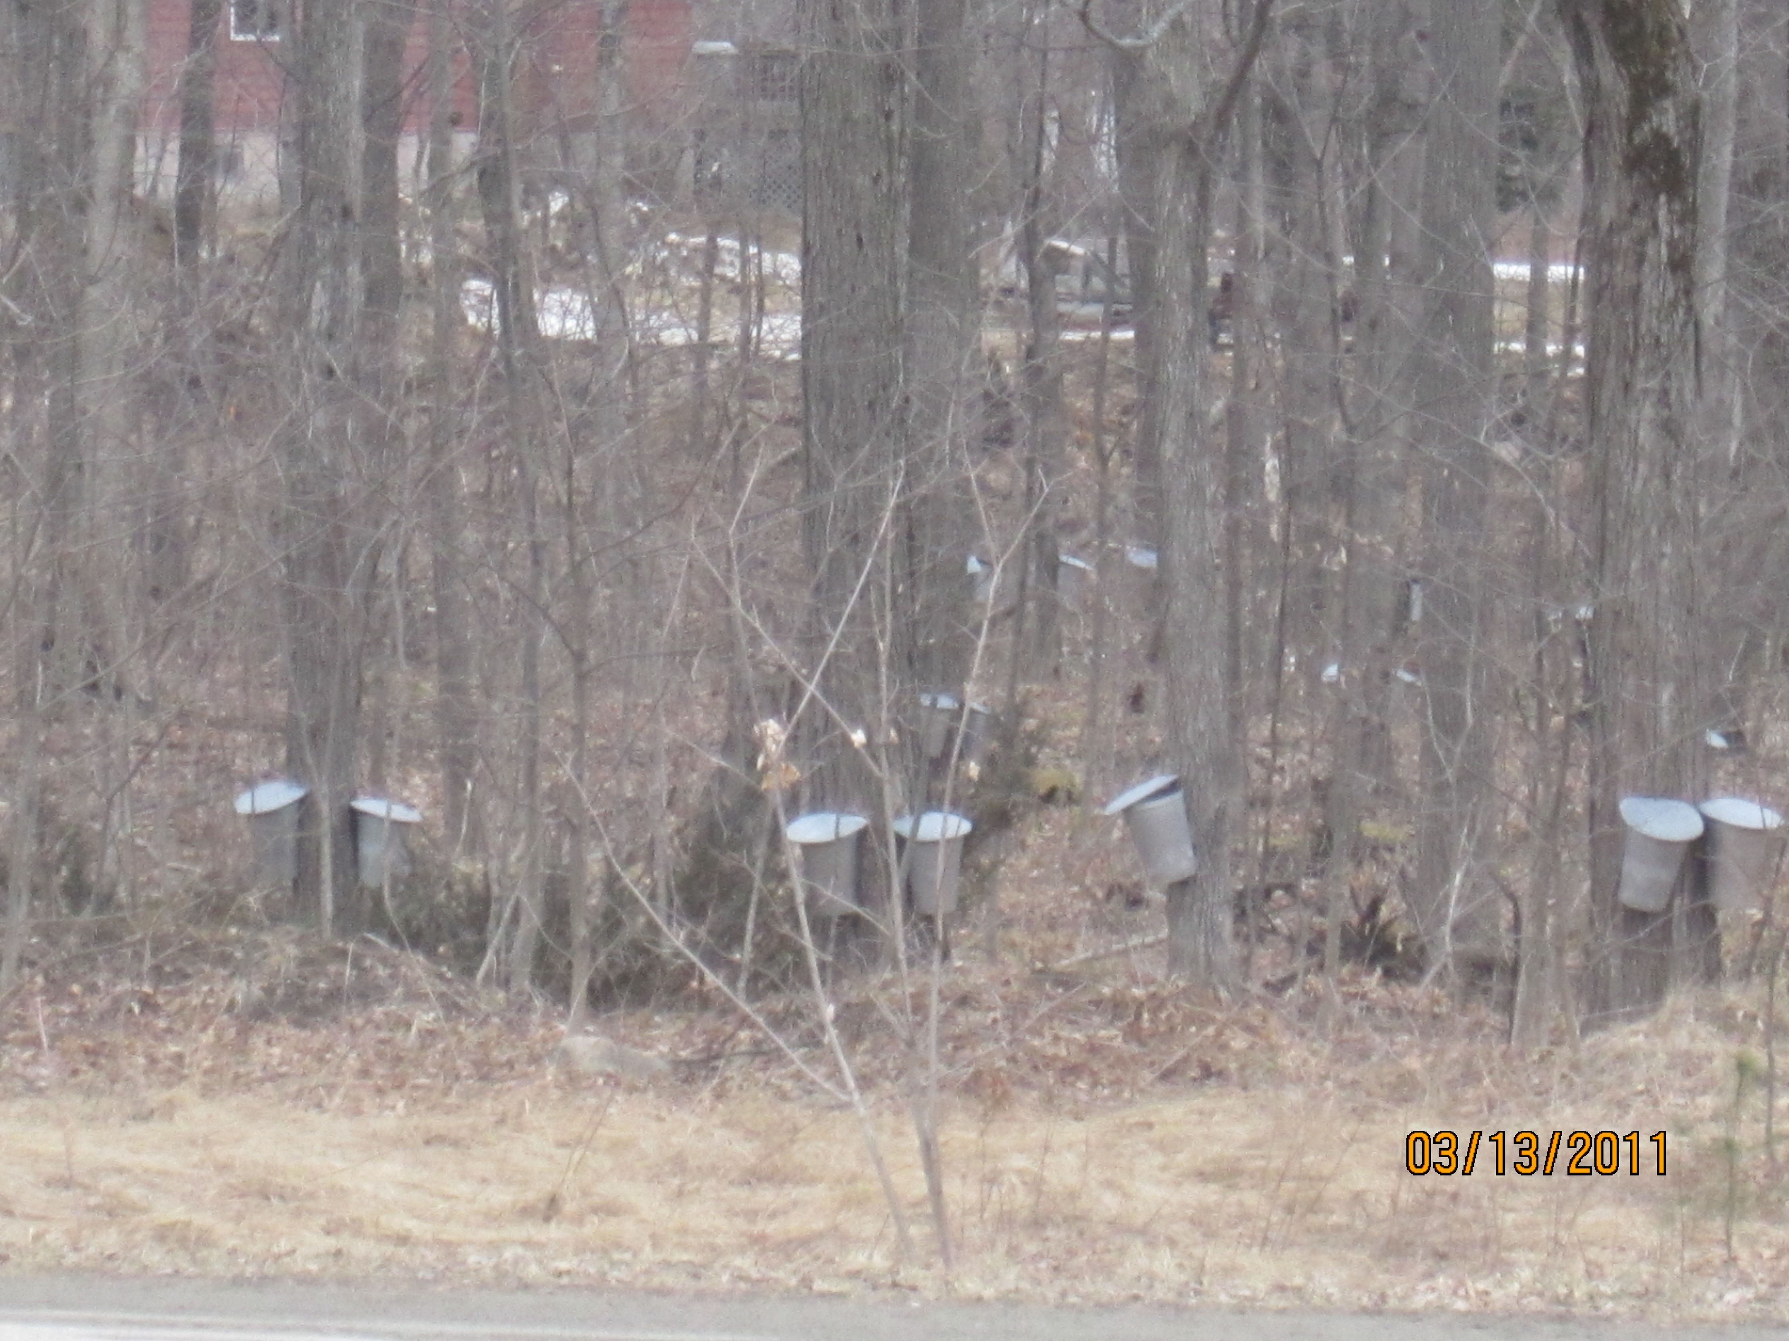
IMSKN RECAP
IMSKN is being developed to aid in the revitalization of maple syrup production by the Aboriginal populations in Ontario
A Toolkit is being developed by IMSKN to aid in this revitalization process, helping participants develop culturally appropriate innovation, resilience and best/wise practices for producing maple sap, syrup and sugar in Ontario

Slide 23
Any
Questions?

Slide 24
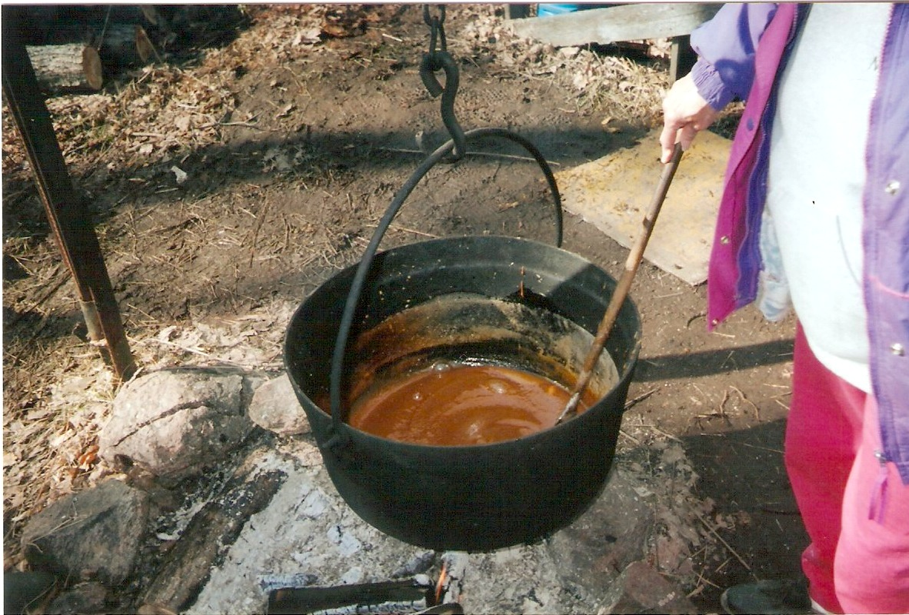
Chii-Miigwetch!

