Slide 1
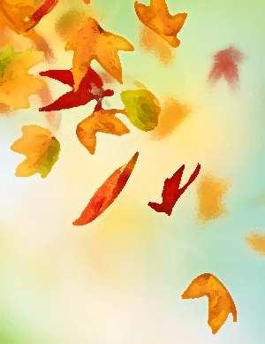
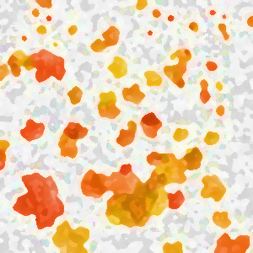
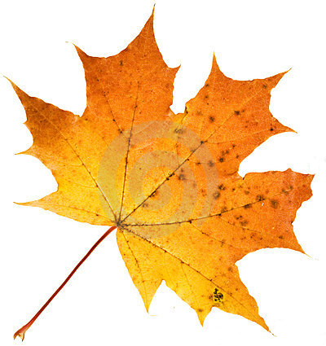
Dr. Brenda Murphy, Contemporary Studies bmurphy@wlu.ca
Resilient Communities Research Collaborative
Sub-Group Affiliation
Resilience
Environment
Resource Management
Research Program
We are the Resilient Communities Research Collaborative led by Dr. Brenda Murphy from Wilfrid Laurier University, Brantford Campus. We are studying rural and Aboriginal resilience with a specific focus on sugar maples and maple syrup.
The Ontario Maple Syrup Agri-Food Value Chain: Enhanced Competitiveness through Innovation and Capacity Development [OMAFRA & OMSPA, $380,000]
Focus: Understand Maple Syrup Value Chain; Innovation and Profitability
Scope & Term: Ontario, 2012-15 (3 yr.)
Maple Syrup, Climate Change and Resilience: A Longitudinal Study
Funders: Social Science and Humanities Research Council ($380,000)
Focus: Understand the Historic and Current Contributions of Maple Syrup to Aboriginal & Non-Aboriginal Resiliency (1700’s – Today) and Understand the Effects of a Changing Climate (Today – 2100)
Scope & Term: Ontario, Quebec, New Brunswick; 2012-17 (5 yr.)
Measuring Progress on Climate Change Adaptation: Lessons from the Community Well-Being Analogue (Natural Resources Canada; $36k, 1yr)
Utilize CWB analogue for lessons applicable to municipal level CC adaptation.
Researcher Photo
Research Program
We are the Resilient Communities Research Collaborative led by Dr. Brenda Murphy from Wilfrid Laurier University, Brantford Campus. We are studying rural and Aboriginal resilience with a specific focus on sugar maples and maple syrup.
The Ontario Maple Syrup Agri-Food Value Chain: Enhanced Competitiveness through Innovation and Capacity Development [OMAFRA & OMSPA, $380,000]
Focus: Understand Maple Syrup Value Chain; Innovation and Profitability
Scope & Term: Ontario, 2012-15 (3 yr.)
Maple Syrup, Climate Change and Resilience: A Longitudinal Study
Funders: Social Science and Humanities Research Council ($380,000)
Focus: Understand the Historic and Current Contributions of Maple Syrup to Aboriginal & Non-Aboriginal Resiliency (1700’s – Today) and Understand the Effects of a Changing Climate (Today – 2100)
Scope & Term: Ontario, Quebec, New Brunswick; 2012-17 (5 yr.)
Measuring Progress on Climate Change Adaptation: Lessons from the Community Well-Being Analogue (Natural Resources Canada; $36k, 1yr)
Utilize CWB analogue for lessons applicable to municipal level CC adaptation.
Research Interests
Risks & Hazards
Climate Change
Community Well-Being
Resilience
Sustainable Development
Indigenous Knowledge
Expertise
Rural Resilience
Social Science
Community Well-Being
Nuclear Waste Management
Aboriginal Resilience
Non-Timber Forest Products
Links to Determinants of Health & Well-Being
Across Ontario, the sugar maples that play an important role in the health and well-being of both Aboriginal and non-Aboriginal communities are being threatened by climate change . We use the focus on sugar maples and maple syrup to ‘tap into’ a wide range of ‘knowledges’ in order to understand the potential effects of climate change on under-studied rural spaces.
Our research addresses these issues by actively involving a multitude of Aboriginal and non-Aboriginal academics, stakeholders and community partners. Diverse partners allow us to integrate the work of academics across the humanities, biophysical and social sciences while being sensitive to cross-cultural perspectives and incorporating other ways of knowing to develop holistic assessments of the impacts of climate change across time and space.
Future Research
Climate Change:
How do researchers engage with the tenets of interdisciplinarity and take seriously the differences in epistemologies when undertaking climate change projects?
Effective Knowledge Mobilization:
How do we undertake climate change education that leads to ‘climate friendly behaviours’?
Rural and Aboriginal Resilience to Disasters:
What are the emergency management strengths, challenges and opportunities for dealing with extreme events in rural and Aboriginal contexts?
P.I. Brenda Murphy bmurphy@wlu.ca
Prj. Mgr. Bryce Gunson bgunson@wlu.ca

