Slide 2
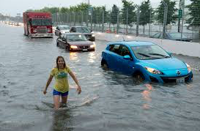
Tabletop Exercise Flash Flood
Insert the Name of your Community
Insert your Community Logo
Insert the Date of the Exercise
Hosted By: Municipality of _____________________
Notes:
Select a name of your Table Top Exercise

Slide 3
Welcome
  Insert name of Facilitator
    Title
    Name of Community/Organization/Company where the Facilitator is from
  Administrative Items
    Emergency exits
    Washrooms
    Vibration mode for cellular devices
    “No duff” in case of real emergency
Notes:
Note: Add you Community Logo to the Master Slide so it appears in the top banner.

Slide 4
Greetings & Opening Remarks
  Mayor ______, Town of _________
Notes:
Add pictures of the Municipal Office

Slide 5
Facilitation Team
  Use this slide if there is more than one Facilitators and/or Subject Matter Expert(s)
Name
  Role (example: Deputy Exercise Facilitator)
  Title and Organization
Name
  Subject Matter Expert
  Title and Organization

Slide 6
Evaluators & Observer
Evaluators
Name
  Title, Name of Organization
Name
  Title, Name of Organization
Observer
Name
  Title, Name of Organization

Slide 7
Participant Introductions
Exercise Players
  Roundtable self-introductions by all members of the Community’s Emergency Control Group

Slide 8
Exercise Agenda
Time | Activity
8:30 a.m. – 8:45 a.m. | Welcome and Exercise Overview
8:45 a.m. – 10:15 a.m. | Module 1: Pre-event Warning Phase
10:15 a.m. – 10:30 a.m. | Nutritional Break
10:30 a.m. – noon | Module 2: Response to Emergency Incident
Noon – 1:00 p.m. | Lunch (Location/Room)
1:00 p.m. – 2:15 p.m. | Module 3: Post-event Recovery
2:15 p.m. – 2:30 p.m. | Nutritional Break
2:30 p.m. – 3:00 p.m. | Hot-Wash
3:00 p.m. | Closing Remarks by Mayor ___________
Notes:
Insert the Name of the Modules
Insert the name of room where lunch will be hosted.
The TTX is scalable. A community may decide do conduct a TTX using one, two or all three modules.

Slide 9
Exercise Needs Assessment
2016 Hazard Identification and Risk Assessment (HIRA) identified floods as a high-priority hazard
Municipality has an Emergency Plan dated _______, and it was last tested/exercised on __________
2016 Exercise After-Action Report identified the following problems and issues: __________
List the improvement measures from the Correction Action Plan require validating

Slide 10
Exercise Needs Assessment
Annual Municipal compliance with Ontario Regulation 380/04- Part II Municipal Standards
  The emergency control group shall conduct an annual practice exercise for a simulated emergency incident in order to evaluate the municipality’s emergency response plan and its own procedures. ON. Reg. 380/04, s. 12 (6).

Slide 11
Exercise Scope
This exercise is a tabletop exercise for the members of the (insert name of Community) Emergency Control Group, led by the Mayor.
Exercise play is limited to discussions at the strategic level as it relates to a flash flood in the community that significantly impacts critical infrastructure.

Slide 12
Statement of Purpose
The purpose of today’s tabletop exercise is to:
  Understand the implications to the Community’s critical infrastructure from a changing climate with the increases in the frequency and severity of weather;
  Determine such vulnerabilities, risks, and impacts;
  Devise and implement adaptive strategies; and
  Improve the Community’s emergency plans and procedures

Slide 13
Exercise Objectives
Understand the link between climate change and the increasing frequency and strength of extreme weather
  Core capability: Planning
Validate the Community’s Hazard Identification and Risk Assessment (HIRA), and confirm that extreme weather hazards have been sufficiently considered in the HIRA
  Core capability: Planning
Test the Emergency Plan and extreme weather hazard-specific annexes to validate emergency procedures
  Core capability: Planning

Slide 14
Exercise Objectives
Educate members of the Community Control Group and emergency responders of their role in emergencies, and enhance inter-organizational coordination
  Core capability: Operational coordination
Evaluate the municipality’s ability to notify Town residents and businesses within ___ minutes of a flood warning issued by _____ Conservation Authority/ Ministry of Natural Resources and Forestry
  Core capability: Public Information & Warning
Evaluate the Emergency Personnel Call-In Policy for activating essential staff
  Core capability: Planning

Slide 15
Exercise Objectives
Practice emergency management and crisis response skills
  Core capability: Planning
Timely emergency declaration, request for outside and/or provincial resources, and preparation of an Incident Briefing Report
  Core capability: Situational Assessment

Slide 16

Exercise Guidelines
Open, low stress, no-fault environment
Varying viewpoints and approaches are encouraged
Base responses on current plans and capabilities
Provide suggestion and recommended actions

Slide 17
Assumptions and Artificialities
Capabilities, plans, systems, and processes will be evaluated
Exercise scenario is plausible
Exercise is conducted in compressed time
All players receive information at the same time

Slide 18
Exercise Structure
3 Modules
  Narrative of scenario and key events
  Moderated plenary discussion following group(s) discussion
  Synopsis of key actions and responses
Module 1: Pre-event Warning Phase
Module 2: Response to Emergency Incident
Module 3: Post-event Recovery

Slide 19
Scenario Narrative
The weather for the past two weeks can be summarized as hot steamy nights, sticky days and torrential downpours. The night-time low temperature was hottest on record, with lots of wind and concentrated bursts of heavy rain amid drought. This has resulted in saturated soil and creeks and streams that have little capacity to drain the storm flow without flooding. Local flood watch messages have been issued stating that there is a potential for flooding in the community.

Slide 20
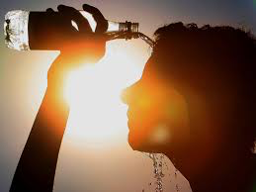
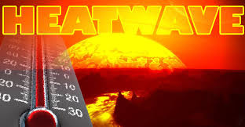
Hottest Year Ever Recorded
Prolonged periods of heat causing health conditions and drought

Slide 21
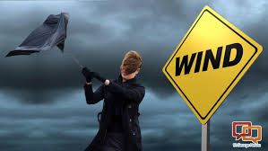
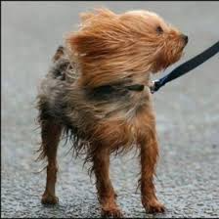
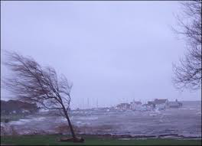
Module 1
Pre-event Warning Phase
See Appendix D of the Exercise Plan for updated weather reports from Environment Canada, and updated flood warning messages from the local Conservation Authority

Slide 22
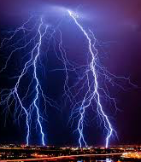
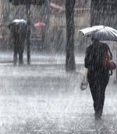
Current Conditions

Slide 23
Module 1: Key Issues
Increasing cases of asthma and other health problems related to poor air quality are straining the capacity of emergency medical services
Older infrastructure, including bridges and culverts may be on the brink of failure
The risk of a power outage from the increasing use of air conditioning is being compounded by erosion by the key above ground and/or underground electricity delivery infrastructure
Drinking waster and sewage treatment facilities are at risk from flooding
Most local businesses do not have business continuity plans or overland flood insurance
Combined storm water and sewer systems are increasing the flood and water contamination potential

Slide 24
Module 1: Discussion Questions
Please refer to pages __ of the Exercise Plan for listing of Module 1 Discussion Questions.
Briefing
  8:45 a.m. – 8:55 a.m.
Group discussion of scenario and questions
  8:55 a.m. – 9:50 a.m.
Brief back with Facilitator
  9:50 a.m.– 10:15 a.m.

Slide 25
Module 1: Discussion Questions
What programs does your municipality have in place to reduce the impacts of flooding?
What are the sensitive and risk prone areas for flooding and drought in your community?
What risks does your community have of future water shortages?
What are the impacts of high temperatures on the health and well-being of your residents?

Slide 26
Module 1: Discussion Questions
What are the health risks from poor water quality?
What are the risk to soils from increased seasonal aridity and wetness?
What are the risks to agriculture and wildlife from scarcity and flooding?
Are land management practices exacerbating flood risk?
What is the risk of cascading infrastructure failures across interdependent networks?

Slide 27
Module 1: Discussion Questions
What are the risks to infrastructure from river, surface/ ground water flooding?
What are the risks to public water supplies and electricity generation from drought and low river flows?
What are the risks to business operations from water scarcity?
What are the risks to businesses from flooding?

Slide 28

Nutritional Break

Slide 29
Scenario Narrative
The local conservation authority issued a Flood Warning to your community, advising that flooding is imminent
Flash or sudden flood is now occurring with little warning time across the community
Municipal Emergency Plan is in operation
Community Control Group has assembled

Slide 30
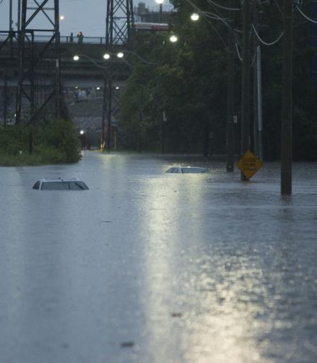
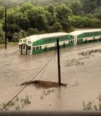
Module 2
Response to Emergency Incident
See Appendix D in the Exercise Plan for updated reports from:
  Environment Canada
  Local Conservation Authority
  Ministry of Natural Resources and Forestry

Slide 31
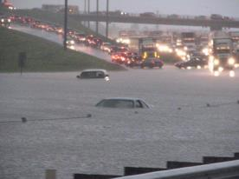
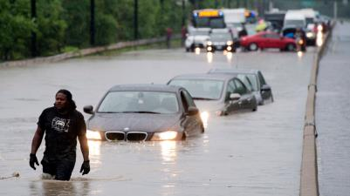
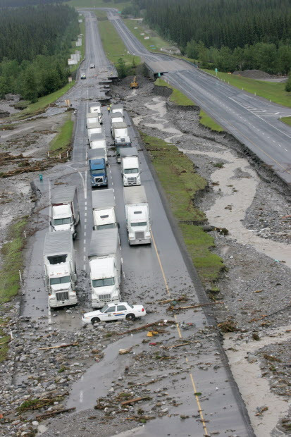
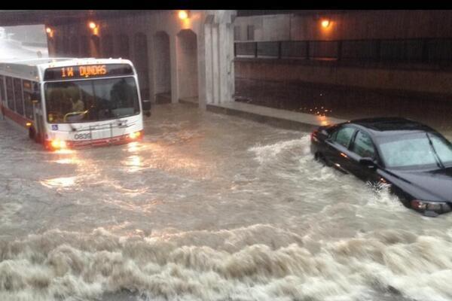
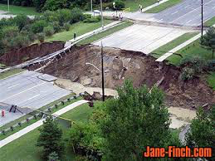
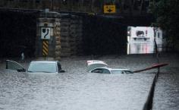
Flash Flooding

Slide 32
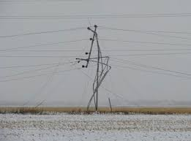

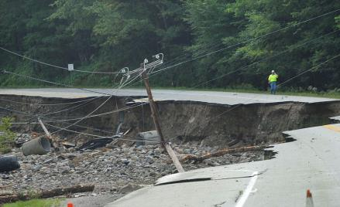
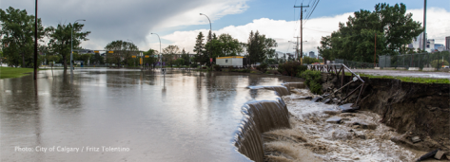
Damage from the Flash Flood

Slide 33
Module 2: Key Issues
Overland flooding plus flooded roads, homes and buildings
Subsidence issues causing concern for buried infrastructure, including high pressure pipelines and high voltage electricity cables
Reduced transmission capacity with loss of hydroelectric power to the community, and substations are flooded
Telecommunication and supply chain disruptions
High river flows impacting bridges, and gas pipelines
Damage from fallen trees and large branches

Slide 34
Module 2: Discussion Questions
Please refer to page ___ of the Exercise Plan for listing of Module 2 Discussion Questions.
Briefing
  10:30 a.m. – 10:40 a.m.
Group discussions of scenario and questions
  10:40 a.m. – 11:30 a.m.
    Town Staff (Room #1)
    All Other Exercise Participants (Room #2)
Brief back with Facilitator in Room
  11:30 a.m. – noon

Slide 35
Module 2: Discussion Questions
What are the key decisions and actions that the Community Control Group is taking as a whole, as well as per each Department/ Organization?
What key issues and/or concerns do you have?
How is the Mayor communicating with the public at risk/ public at large, and what are the key messages?
What are the elements of the Situation Report, and how is information being collected and disseminated, and to whom?
What assistance from outside the community may be called upon, and how will this be undertaken?

Slide 36
Lunch – Location/Room
Notes:
Insert the location of lunch

Slide 37
Scenario Narrative
The flash flood storm is over and the torrential downpour has stopped
The 9-1-1 call-taking centre is overloaded with calls for assistance
Citizens have returned to their homes to find extensive damage, and insurance adjusters are enroute to the community
The volume of water in the river/stream has begun to recede
Clean up and restoration activities have begun

Slide 38
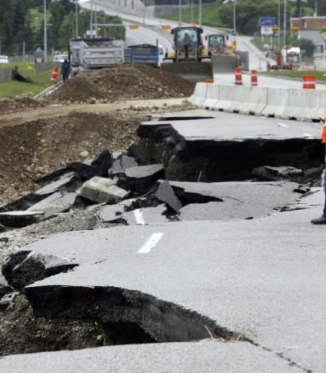
Module 3
Post-event Recovery
See Appendix D of the Exercise Plan for updated reports:
  Environment Canada Weather Report
  Watershed Conditions Statement issued by the local Conservation Authority

Slide 39
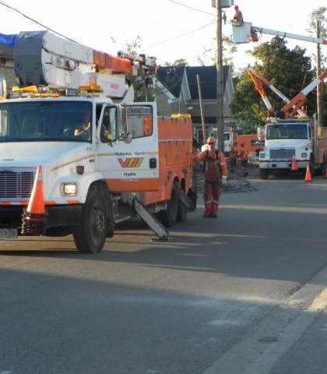
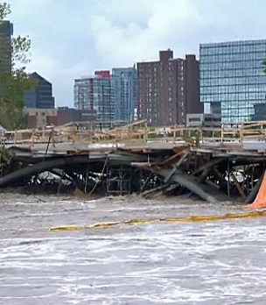
Damaged Infrastructure

Slide 40
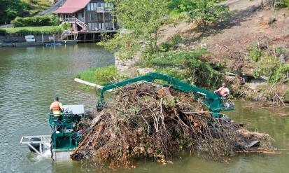
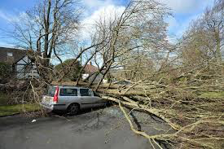
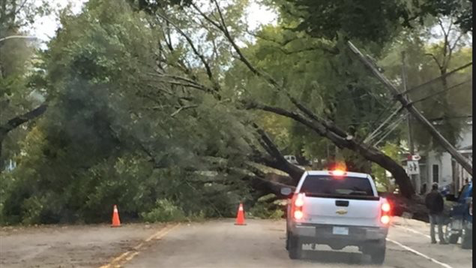
Damage from Fallen Trees

Slide 41
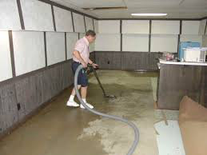
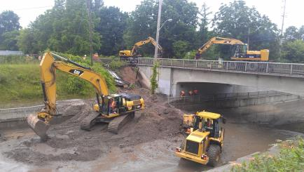

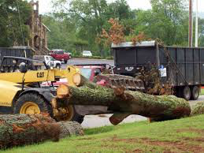
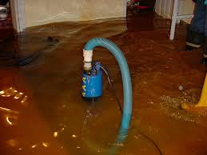
Recovery

Slide 42
Module 3: Key Issues
Many damaged homes, businesses, buildings, cars, energy and transportation infrastructure, and agricultural assets
Financial hardship of costly home repairs, lost wages
Down wires and scattered debris that needs to be removed
Emergency crews are running out of daylight
Repair and restoration of damaged public facilities
Outside emergent volunteers and curious people are attempting to get into the community
Media outlets are covering the story

Slide 43
Module 3: Discussion Questions
Please refer to page __ of the Exercise Plan for listing of Module 3 Discussion Questions.
Briefing
  1:00 p.m. – 2:15 p.m.
Group discussion of scenario and questions
  1:10 p.m. – 1:45 p.m.
    Mass Casualty Response Group (Room 1)
    All Other Exercise Participants (Room 2)
Brief back with Facilitator
  1:45 p.m.– 2:15 p.m.

Slide 44
Module 3: Discussion Questions
What are the total economic consequences, taking into account the destruction of natural assets?
What bill will tax payers be left picking up?
How will displaced people be accommodated?
How will the repair and restoration of damaged public facilities, and transportation networks be undertaken?
How will the municipality communicate with the public regarding under the Disaster Financial Assistance Arrangements Program?
What are the risks and opportunities from the changing demand for goods and services?

Slide 45
Nutritional Break

Slide 46
Hot-Wash
Strengths
Areas for Improvement

Slide 47
Closing Comments
Name , Exercise Facilitator
  Participant Feedback Forms
  Next Steps - Evaluation
  After-Action Report will be e-mailed to the Community Emergency Control Group on _______
  Announce date of the After-Action Meeting
Mayor _____, Name of Community
  Acknowledge the Facilitator, Observers, SME, Evaluators, and fellow members of the Community ECG
  Thank the Emergency Management Program Committee, and Exercise Planning Team
Notes:
Thank the exercise participants for their time and participation at the TTX, and Hot Wash.

