Slide 1
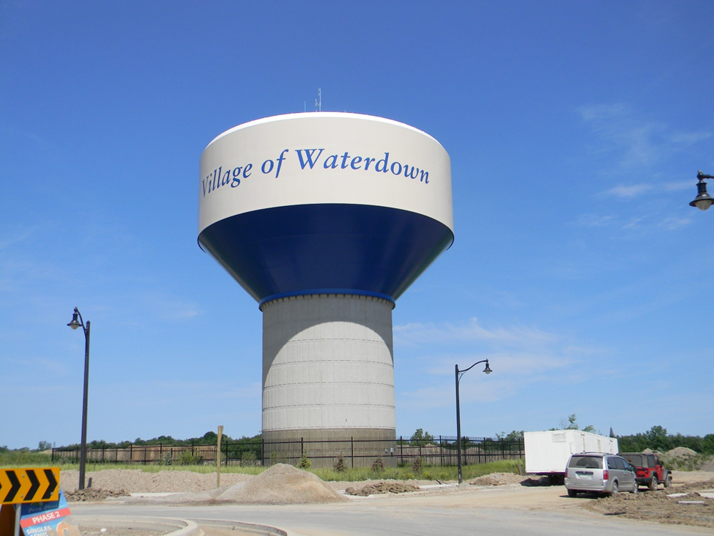
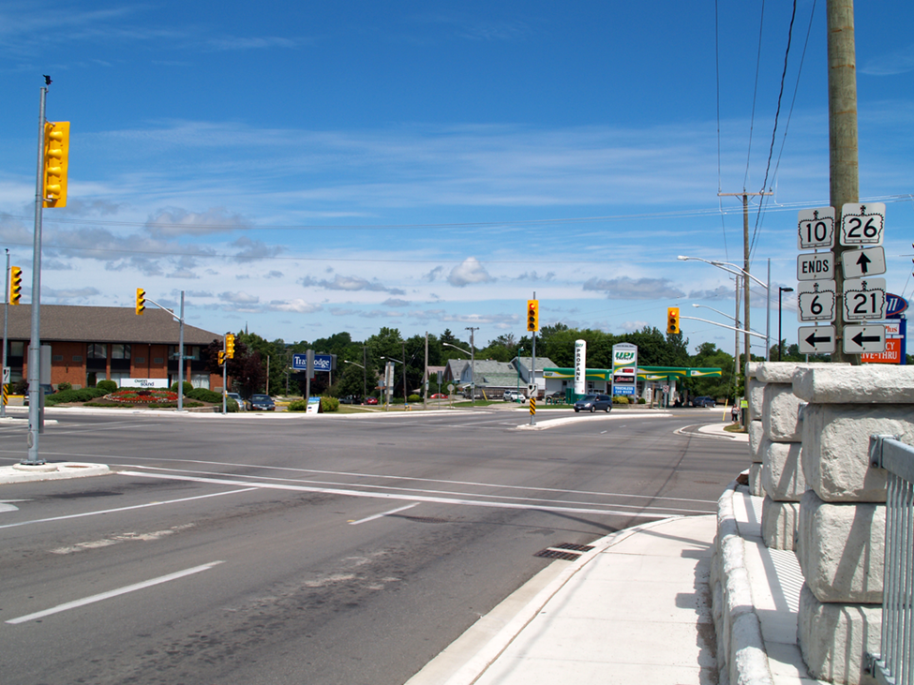
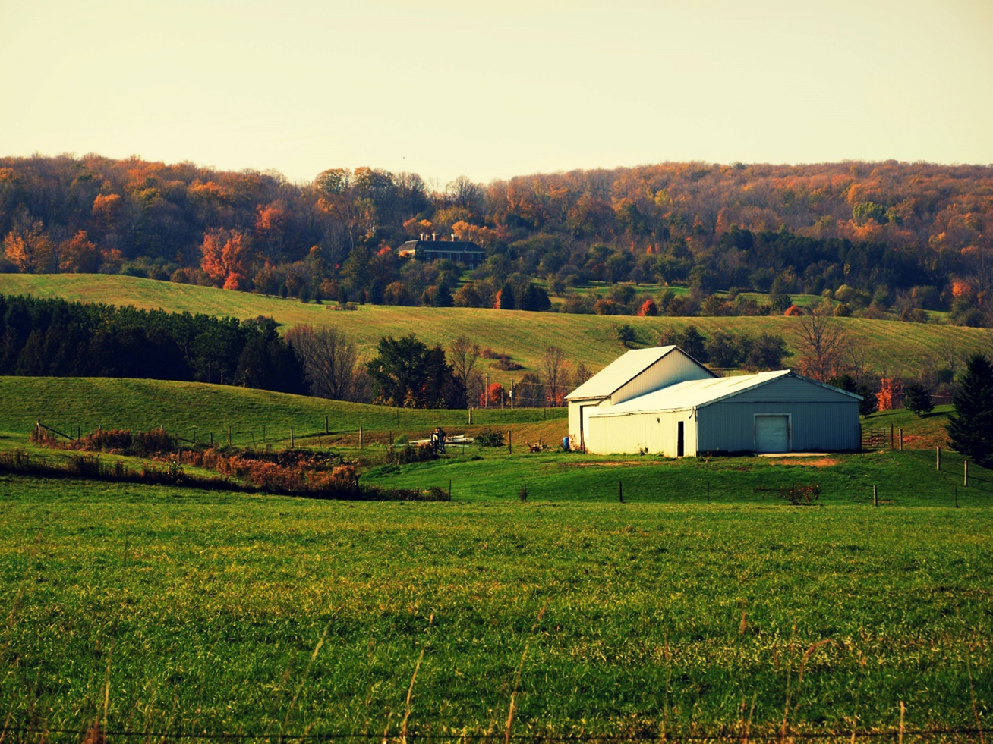
Inter-Community Service Collaboration: Enhancing Rural Infrastructure Preparedness for Climate Change
Project Results and Key Findings
Dr. Brenda Murphy (PI) and Bryce Gunson, PhD.(c)
Wilfrid Laurier University

Slide 2
Accessing the toolkit
All documents related to this project are available online (free of charge) from our website
www.resilientresearch.ca
under ‘publications’

Slide 3
Project details
Funder: Ontario Ministry of Agriculture, Food, and Rural Affairs (OMAFRA) (New Directions Research Program)
3 yr. project 2016-19
$196,500 in funding
Project stages
Literature review
Key-informant interviews
Provincial survey
10 case studies

Slide 4
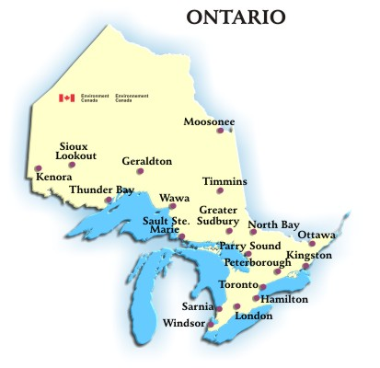
Research purpose
1) Assess the potential of inter-community service cooperation (ICSC) as a possible tool to address the impacts of CC in small (500-7500 pop.) Ontario rural communities south of the Sudbury region.
2) Understand the extent to which such collaboration and the impacts of CC are, or could be, embedded within the community’s infrastructure (asset) management processes (AMP)
Study Area is Southern Ontario

Slide 5
Inter-community service cooperation and Asset management planning
ICSC is the provision, sharing, or procurement of infrastructure and services between two or more communities
AMP is a formalized municipal process
Lifecycle analysis of all assets
Question: How could ICSC help rural communities deal with the impacts of CC on their infrastructure and the services provided???

Slide 6
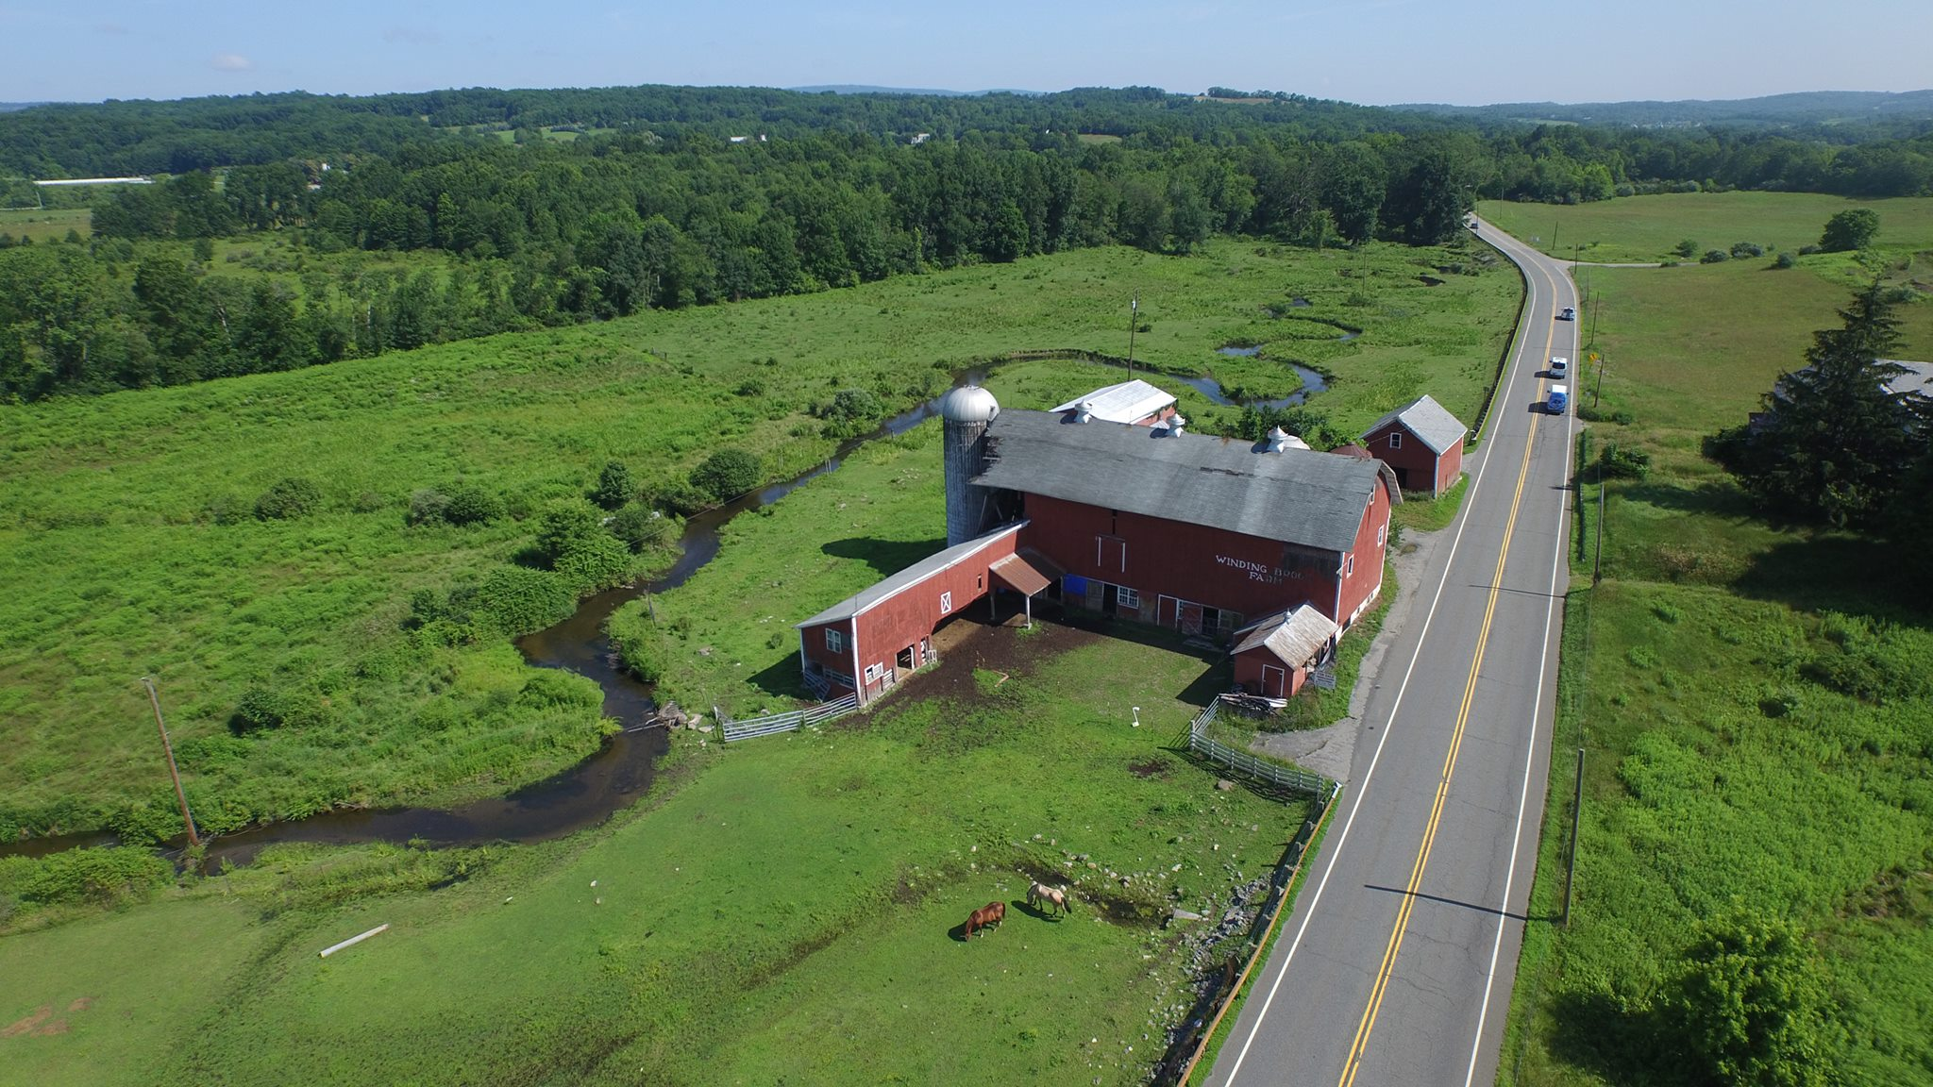
Literature review and key informant interview findings
Small Ontario rural municipalities face challenges
Distance between communities
Geographic complexity and size of municipality
Limited tax base
High infrastructure/tax-base ratio
Limited full-time staff
Inadequate analytical capacity
Old patterns and relationships preclude cooperation
Lack of information about climate change impacts and/or adaptation options

Slide 7
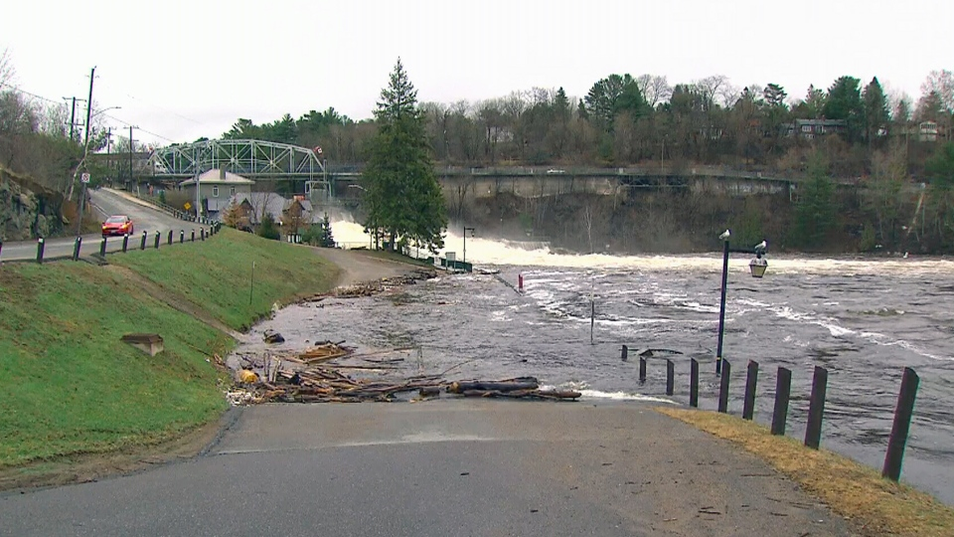
Provincial survey findings
Online survey directed to Ontario public works and community emergency management coordinator staff in 163 communities (500-7500). 34 surveys returned (21% response rate).

Slide 8
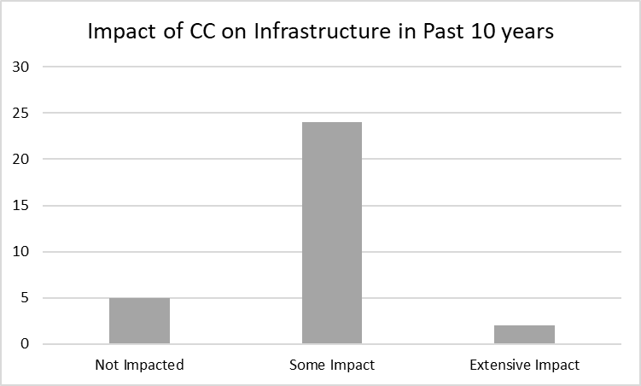
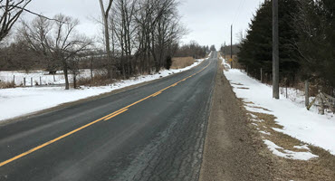
Provincial survey findings – CC Impact
84% of study communities have experienced CC impacts on their infrastructure in the past 10 years.
Grouping together the responses representing some impact and extensive impact, the infrastructure most affected were roads and bridges (27), stormwater and wastewater management (15), fire or emergency services (13), community and social infrastructure (9) and drinking water. (5)

Slide 9
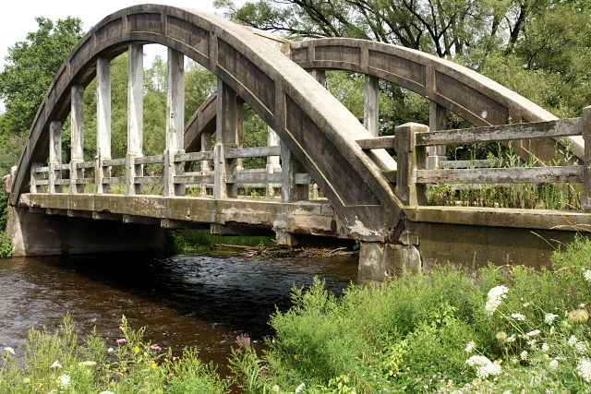
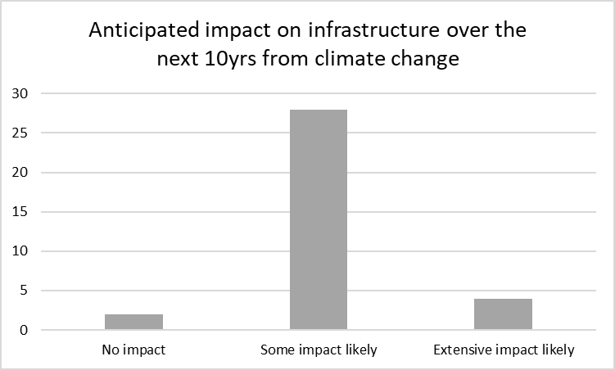
Provincial survey findings – CC Impact
Looking into the future, 94% of responding communities indicated that extreme weather or climate change will have an impact on their community’s infrastructure in the next 10 years
Grouping together the responses representing some impact and extensive impact, the infrastructure expected to be impacted the greatest are roads and bridges (27), stormwater and wastewater management (15), fire or emergency services (13), community and social infrastructure (9) and drinking water (5)

Slide 10
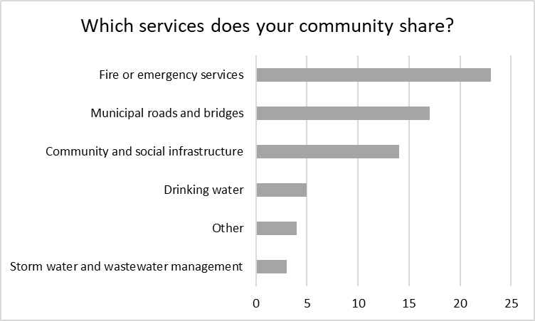
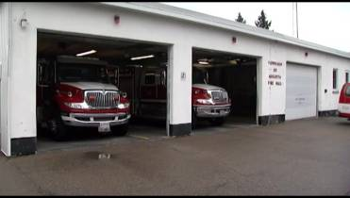
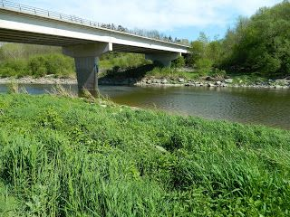
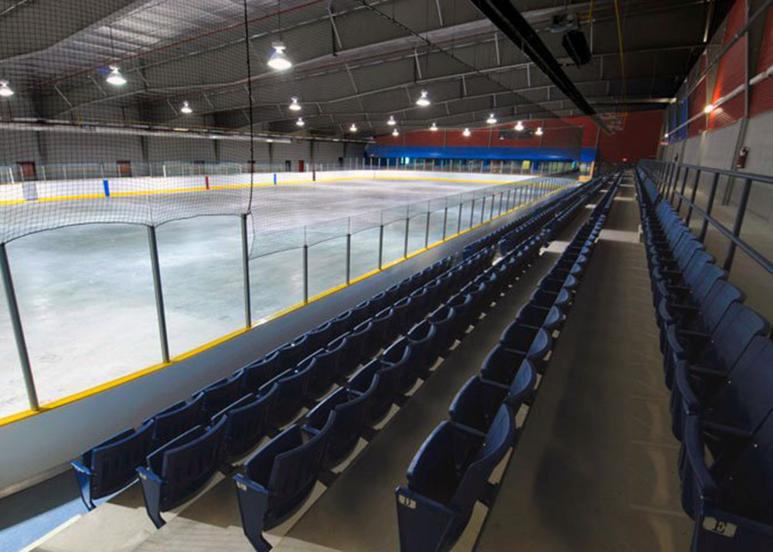
Provincial survey findings - ICSC
Communities that share services

Slide 11
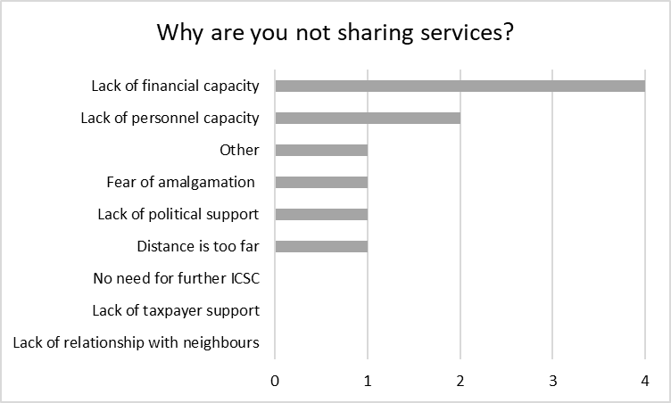
Provincial survey findings - ICSC
Communities that DO NOT share services

Slide 12
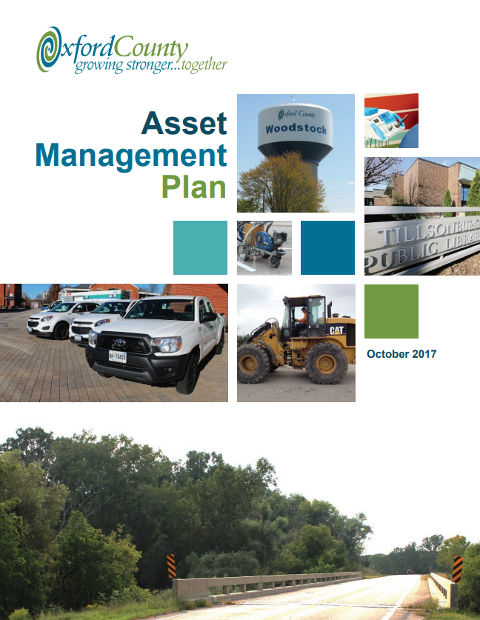
Provincial survey findings - AMP
Only one community had not completed an AMP
73% of AMP’s had been in place for more than one year
Respondents noted that although their municipality has a plan, they don't have the capability to fund it.

Slide 13
East Farris
Case Study Communities
French River
Lake of Bays
The Blue Mountains
Frontenac County
Barrie
Grand Valley
Region of Waterloo
Perth South
Brantford

Slide 14
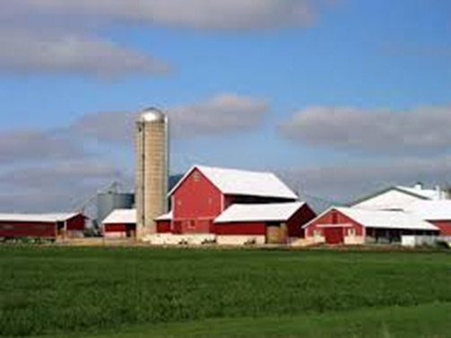
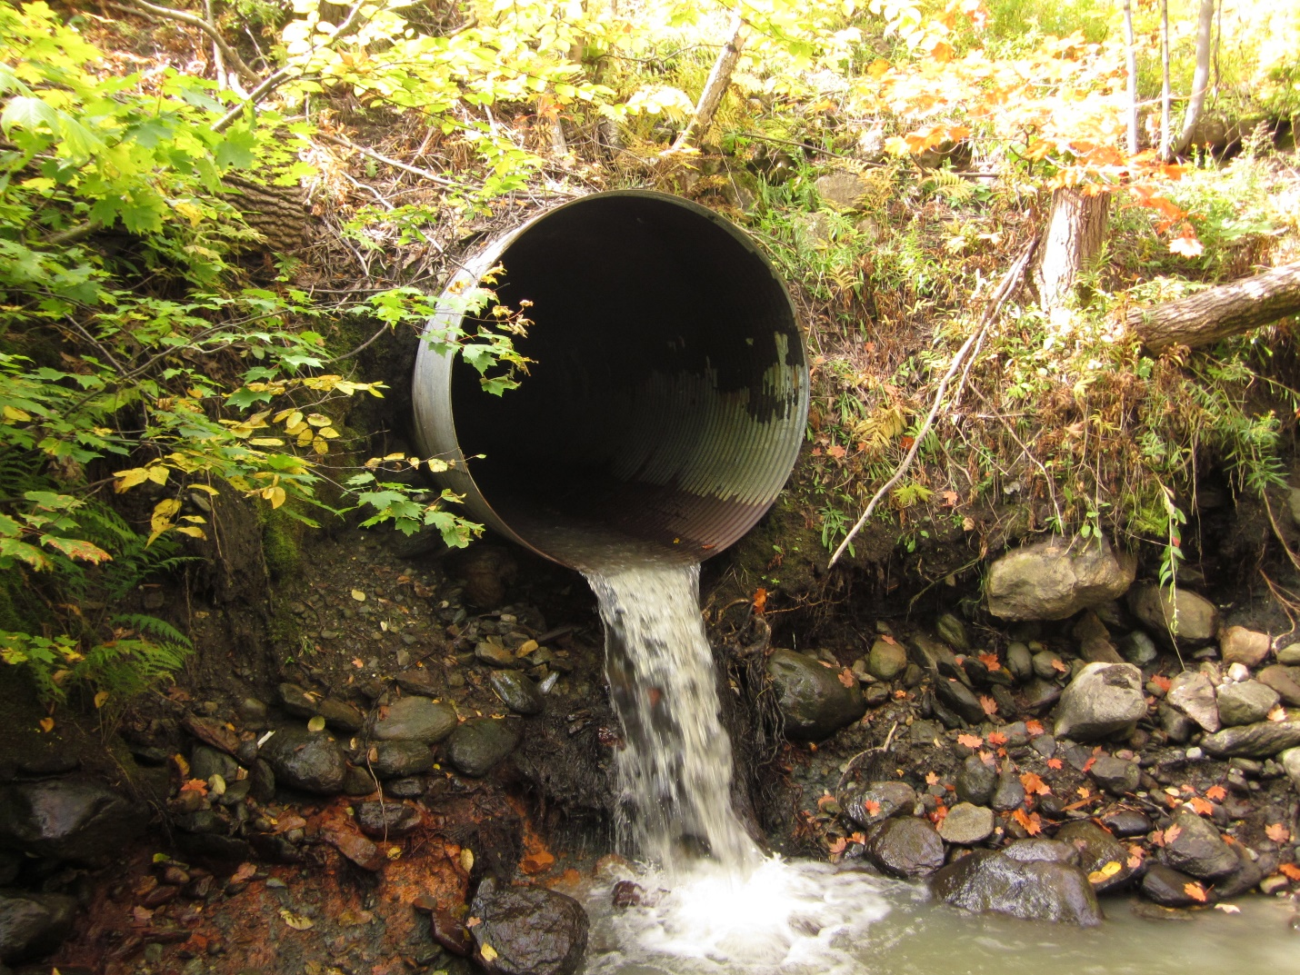
Case Study Findings
10 case studies were organized into themes for comparison
Background
Characteristics of Cooperative Agreements
Infrastructure and Asset Management Planning
Climate Change Impact on Infrastructure Sectors
Climate Change Preparedness
Climate Change-Prepared Cooperation: Possibilities and Best Practices

Slide 15
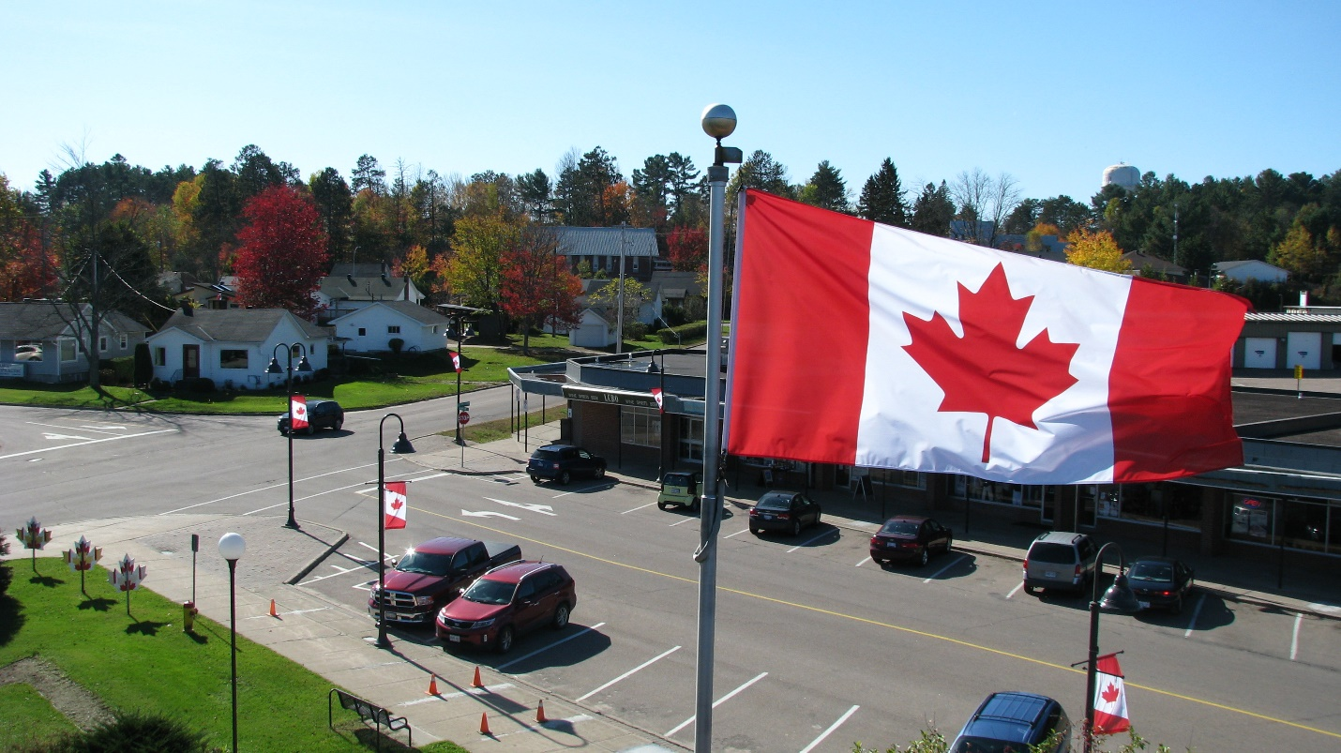
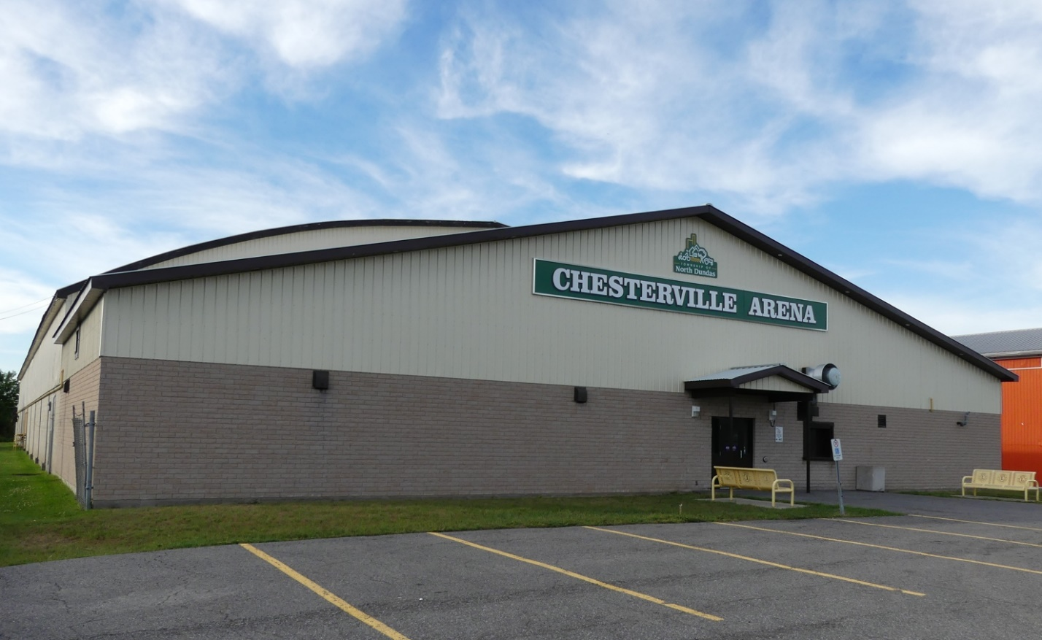
Case Study Findings
We developed a series of best-practices tailored to communities considering cooperation with their neighbours, which include:
Clearly identify the municipality service needs, then communicate with neighbours to assess the possibility of partnering
Be open to sharing resources with your neighbours; all municipalities have limited resources and sharing a service might be beneficial for both jurisdictions
Start small to build up confidence and experience; work up to bigger issues

Slide 16
SWOT Analysis
Strengths
Ongoing Service Cooperation Agreements
Basic Climate Change Preparedness Measures
Ongoing Infrastructure Management
Weaknesses
Barriers and Limitations to Service Cooperation
Infrastructure Deficits and the Impact of Climate Change
Limitations of Asset Management Plans for Climate-Change Preparedness Decision-Making
Shortage of Integrated and Targeted Climate Change Preparedness Activities
Impacts from Extreme Weather Events
Notes:
As expected, service cooperation is quite common across rural municipalities with fire or emergency services and municipal roads and bridges topping the list for services shared.
As time and resources permit, rural municipalities have been undertaking a range of activities that contribute to infrastructure preparedness including integration of CC adaptation into planning, cooperating with neighbouring communities or regional county governments to improve preparedness, preparing educational materials, working with conservation authorities, etc
On the positive side, most surveyed municipalities and all case study municipalities indicated that service cooperation was often considered or already in place to help address the infrastructure needs of their jurisdictions. Most had completed AMPs and many suggested that their jurisdictions planned on updating their AMPs to include the impacts of CC.
Barriers to service cooperation include lack of personnel capacity (such as employee education and training), political support, limited financial capacity (often related to a smaller tax base and less diversified economic development), lack of knowledge and time to develop service agreements, lower population densities and longer distances between communities. CC preparedness is not usually part of the conversation when service cooperation agreements are considered. Rather, it is an added, but often unconsidered benefit. Further, AMPs and other locally relevant planning and decision-making documents are often silent about service cooperation.
Infra deficits There is much research across Canada and internationally documenting that municipalities are currently facing enormous infrastructure deficits, mostly due to aging infrastructure. In the current study, infrastructure gaps and budget shortfalls were noted by interview respondents in all of the case study communities. The extreme weather expected under a changing climate is expected to exacerbate this problem. Rural municipalities are often reactive, dealing with extreme weather events as they occur. There is often inadequate consideration of CC projections and risks during infrastructure planning processes as well as less attention to holistic extreme weather contingency funding.
Limitations - The results indicate that there are limitations to the effectiveness of AMPs for evidence-based decision-making. First, communities lack sufficient knowledge about CC impacts to infrastructure and appropriate adaptation measures to adequately inform AMP processes. Second, the AMP process and document was not necessarily well understood by staff and elected officials or by the public, thus limiting its value to local decision makers. Third, since these plans are often completed as point-in-time documents by an outside consultant, the AMPs may not be ‘living’ documents that are useful in providing up-to-date information or future projections.
Shortages- At the local level, given tight budgets and stretched personnel, it has proven difficult for climate change preparedness to be more fully integrated into ongoing municipal activities. Although survey respondents indicated that CC is being integrated into planning, the case study results suggest that rural municipalities are undertaking climate change preparedness activities on a more ad hoc basis, mostly during reconstruction from an extreme weather event such as a culvert washout.
Virtually all rural municipalities involved with the project had experienced some form of extreme weather event. The most prominent hazard was flooding followed by winter and summer storms, heat related events, and in some jurisdictions, forest fires.

Slide 17
SWOT Analysis
Opportunities
Rural Municipal Preparedness Within an Interconnected Infrastructure Network
Predictable, Mitigation-Oriented Funding to Ensure Infrastructure Preparedness
Locally Relevant, Down-Scaled Climate Change Projections
Threats
Demographic Trends
Future Impacts from Climate Change
Notes:
Rural Municipal Preparedness Within an Interconnected Infrastructure Network
Rural municipalities provide infrastructure services within a nested and interconnected network. For instance, at the simplest level, two municipalities may share responsibility for boundary roads and bridges. Located within watersheds, municipalities may cooperate on flood management with local conservation authorities. Thus, there are multiple ways for municipalities to increase their preparedness through cooperation with broader scale jurisdictions and agencies. Yet, although a municipality may be responsible for roads, bridges, frontline emergency or fire response and other infrastructure services, the capacity to efficiently and effectively deliver services is enabled by broader provincial and federal policy frameworks and infrastructure networks. Effective and cost-efficient rural CC-preparedness is enhanced when these frameworks and networks take into consideration the distinctive needs of rural municipalities.
Predictable, Mitigation-Oriented Funding to Ensure Infrastructure Preparedness
Given that rural municipalities are already facing the impacts of extreme weather events and often have the local knowledge necessary to translate broader directives into doable, effective preparedness, it makes sense to invest in local preparedness. Attainment of rural infrastructure preparedness and long-term planning would be substantially improved if provincial and federal partners established grant programs with reliable annual entitlements and predictable application packages and schedules. Additionally, mitigation funding to proactively address the most likely CC impacts and the recovery of costs incurred when reconstructing infrastructure to more stringent CC standards would further ensure rural municipal preparedness.
Locally Relevant, Down-Scaled Climate Change Projections
Using historic climate trends and extreme weather events does not always capture the future patterns projected under a changing climate. Further, national-level climate models will not give rural municipalities the information they need to make well-informed decisions. Rural municipalities need long-term, locally relevant climatic projections to undertake realistic asset management planning processes and life cycle forecasting. Rural communities might consider obtaining relevant down-scaled climate projections through a cooperative agreement with other jurisdictions within their region or watershed.
Demographic Trends
Rural municipalities are often facing the impacts of some larger national demographic trends including aging populations and out-migration. These factors reduce tax dollars and limit the qualified personnel available to address infrastructure needs. However, some municipalities are experiencing overall population growth, seasonal growth due to part-time residents as well as increasing tourism-based industries. These growth factors can also add extra pressure to an already strained rural infrastructure system.
Future Impacts from Climate Change
The project results indicate that extreme weather has impacted rural Ontario municipal infrastructure in the past and that most expect the impacts to continue into the future. The rural infrastructure most affected are roads and bridges, stormwater and wastewater management and fire and emergency services. It will become increasingly important to undertake preparedness activities to mitigate the most likely threats.

Slide 18
Key messages
Rural Ontario communities are being impacted by CC and often don’t have the resources to cope effectively
Despite challenges
Municipalities attempting to address CC impacts on infrastructure
Recognize the value of ICSC
Long-standing cooperation around fires services can be used towards the development of other shared services
Key to development and maintenance of ICSC
Geography does not need to be a barrier
Services shared could be the non-structural system elements
Training, personnel, equipment

Slide 19
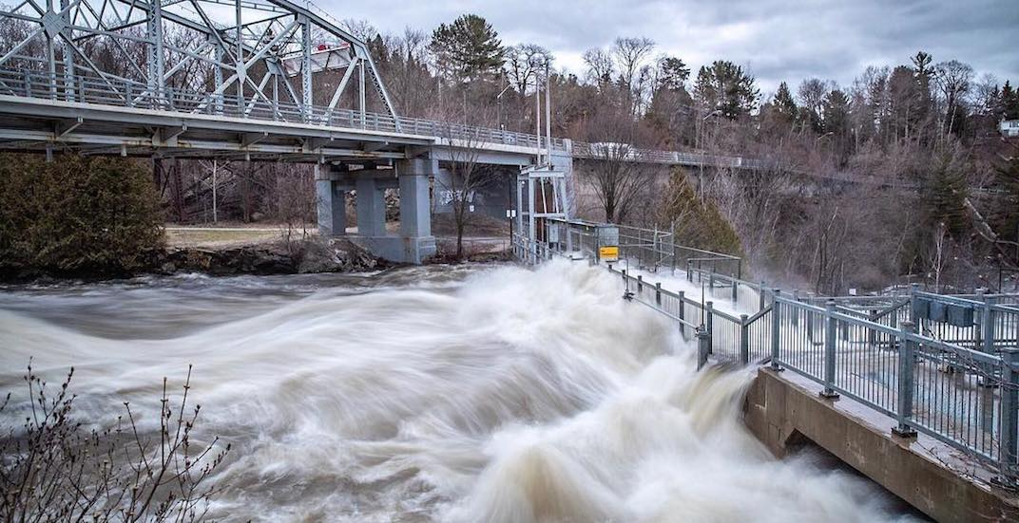
Thank you!

